Slide 1

Opioid Tapering
Paul Coelho, MD
David Tauben, MD
Melissa Weimer, DO, MCR

Slide 2
Objectives
Understand how to calculate morphine equivalents per day
Understand the steps necessary to plan a successful opioid taper
Describe several opioid taper case scenarios

Slide 3
Diagnose & Calculate MED
Substance Use Disorder
  including opioids, alcohol, etc
Diversion
At risk for immediate harms
  Aspiration, hypoxia, bowel obstruction, overdose, etc
  Refusing monitoring (urine drug testing, abstain from marijuana or alcohol, etc)
Therapeutic Failure of opioids
At risk for future harms (>50-90 MED, benzos)
  High dose chronic use without misuse
  Concomitant benzos
  Sleep apnea

Slide 4
Enduring adaptation produced by established behaviors
Opioid use disorder criteria may be different for pain patients on chronic opioids
For the illicit user
  Procurement behaviors
For the patient with pain – much more complex
  Continuous opioid therapy may prevent opioid seeking
  Memory of pain, pain relief and possibly also euphoria
  Even if the opioid seeking appears as seeking pain relief, it becomes an adaptation that is difficult to reverse
  It is hard to distinguish between drug seeking and relief seeking
Ballantyne JC, et al. New addiction criteria: Diagnostic challenges persist in treatment pain with opioids.
IASP: Pain Clinical updates, Dec 2013.

Slide 5
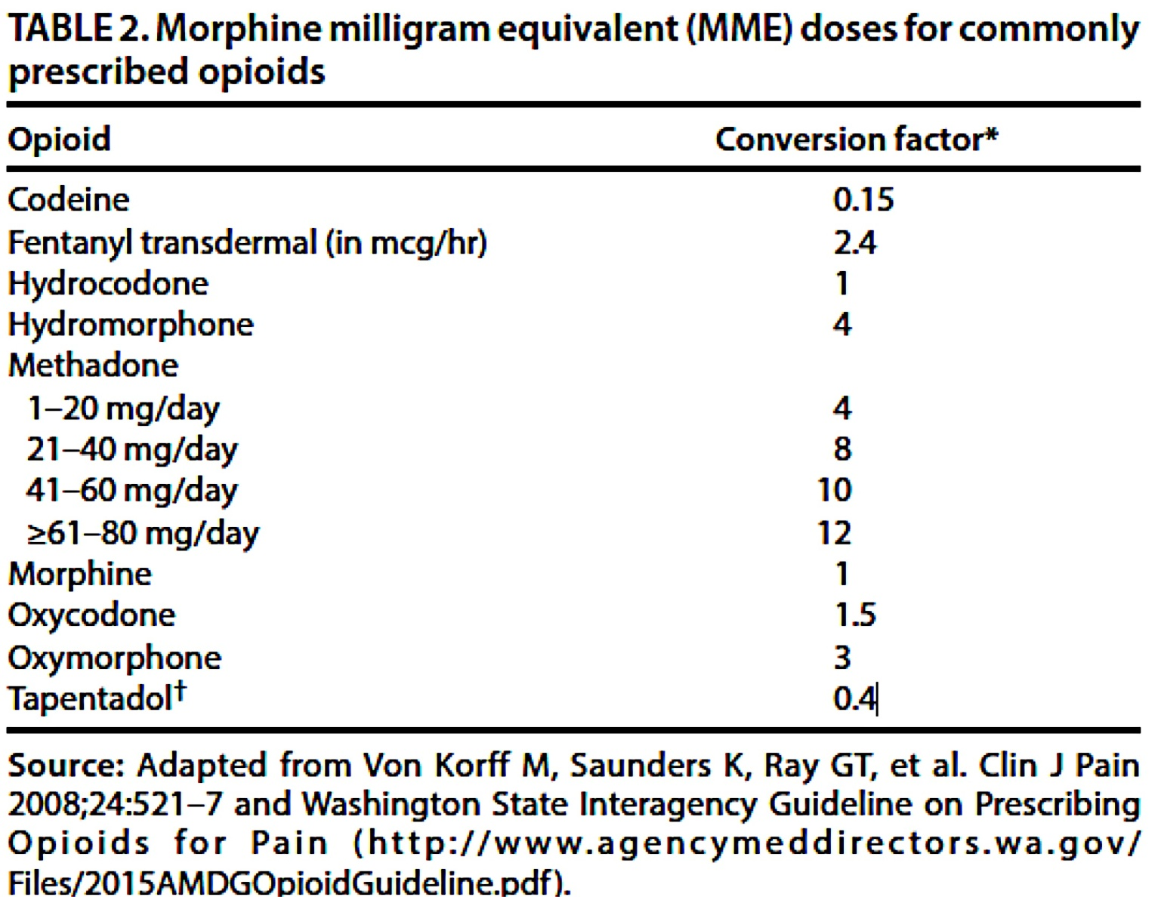
Calculating Morphine Equivalent Dose
**DO NOT USE FOR OPIOID ROTATION**

Slide 6

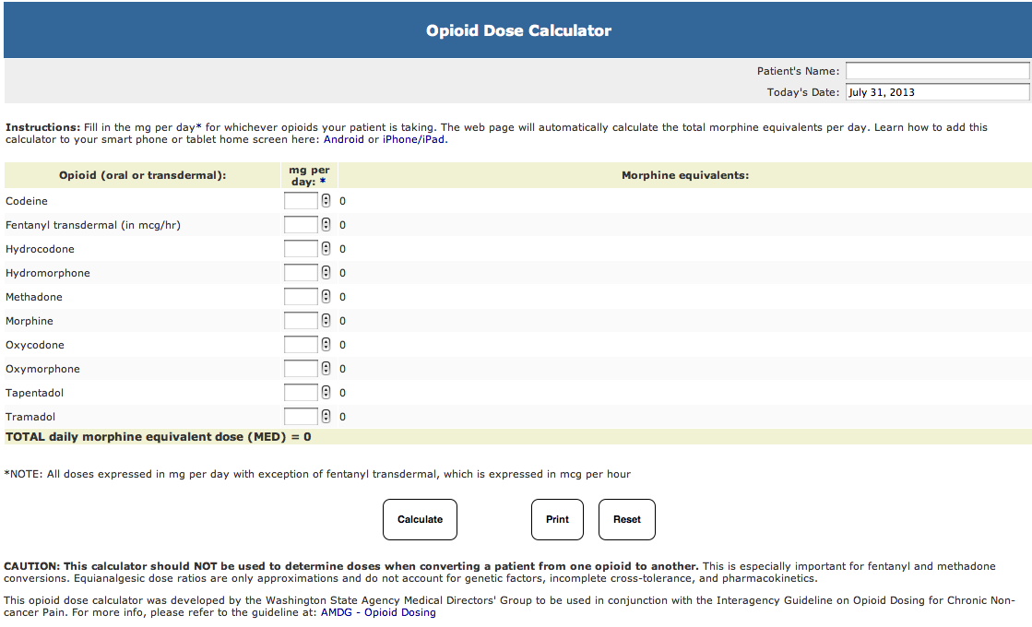
CALCULATE THE MED (or “MME”)
  AMDG on-line calculator
  www.agencymeddirectors.wa.gov
  Methadone
  <20 mg 4x
  >20-40 mg 8x
  >60-80 mg 10x
  >80 mg 12x
Notes:
Added Washington State AMDG calculator (used by CDC

Slide 7
Calculating Morphine Equivalent Dose
Fentanyl 25mcg/hr patch
  25 x 2.4 conversion factor (CF) = 60mg MED
Hydromorphone 2mg every 4 hours + Oxycodone 60mg BID
  2mg x 6 = 12mg x 4 CF = 48mg MED
  60mg x 2 = 120mg x 1.5 CF = 180mg MED
  TOTAL 228mg MED
Methadone 20mg TID
  20mg x 3 = 60mg x 10.0* CF = 600mg MED
  *seek expert advice

Slide 8
Taper plan and start taper
Discuss goals of taper —how and when will we know if it is successful?
  Establish dose target and timeframe
  Maintain current level of analgesia (may not be possible in short term)
Discuss potential withdrawal symptoms
  Temporary increase in pain
  Discuss how to contact
  Schedule follow-up or nurse check ins
Identify at least one self-management goal

Slide 9
How to approach an opioid taper/cessation
Issue | Recommended Length of Taper | Degree of Shared Decision Making about Opioid Taper | Intervention/Setting
Substance Use Disorder | No taper, immediate referral | None – provider choice alone | Intervention: Detoxification with medication assisted treatment (buprenorphine or methadone), Naloxone rescue kit Setting: Inpatient or Outpatient Buprenorphine (OBOT)
Diversion | No taper* | None – provider choice alone | Determine need based on actual use of opioids, if any
At risk for immediate harms | Weeks to months | Moderate – provider led & patient views sought | Intervention: Supportive care Naloxone rescue kit Setting: Outpatient opioid taper
Therapeutic failure | Months | Moderate – provider led & patient views sought | Intervention: Supportive care Naloxone rescue kit Setting: Outpatient opioid taper Option: Buprenorphine (OBOT)
At risk for future harms | Months to Years | Moderate – provider led & patient views sought | Intervention: Supportive care Naloxone rescue kit Setting: Outpatient opioid taper Option: Buprenorphine (OBOT)
Notes:
http://www.sciencedirect.com/science/article/pii/S0738399105001783
Shared Decision Making: Makoul and Clayman, Patient Education and Counseling, Vol 60, Issue 3, March 2006, pages 301-312
***the degree of decision making may only be initial and is subject to change. In my opinion, the provider needs to “hold the line” to keep the taper going when things get rough.
MTD >30 and MED >200 -> bup after tapering to 30 of MTD and 200 of MED
MTD < 30 and MED <200 → taper or bup
Research to date did not find long term benefits to giving patients control over their taper when compared with a masked taper

Slide 10
Use a Risk-Benefit Framework
NOT…
Is the patient good or bad?
Does the patient deserve opioids?
Should this patient be punished or rewarded?
Should I trust the patient?
RATHER…
Do the benefits of opioid treatment outweigh
the untoward effects and risks for this patient (or society)?
Judge the opioid treatment –
NOT the patient
Nicolaidis C. Pain Med. 2011 Jun;12(6):890-7.
Notes:
In terms of a viable framework, this all makes sense if we always think about issues around opioids as health-related issues. So, it’s not is the patient good or bad, or does the patient deserve to have opioids, whether we should reward them if they behave well and punish them if they might be aiming towards misuse.
We need to frame this instead as a risk/benefit assessment for an individual patient. So, if a patient has a history of substance misuse or mental health disorders that may make them more at risk, we are implementing these strategies in order to keep them safe. And when issues arise, we need to think of what might be driving them in terms of the patient’s health. So, these strategies are for the benefit of the individual patient and for the benefit of society or the public health.

Slide 11
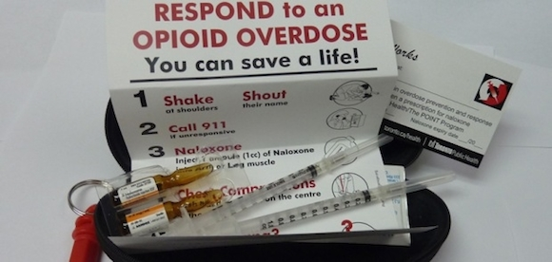
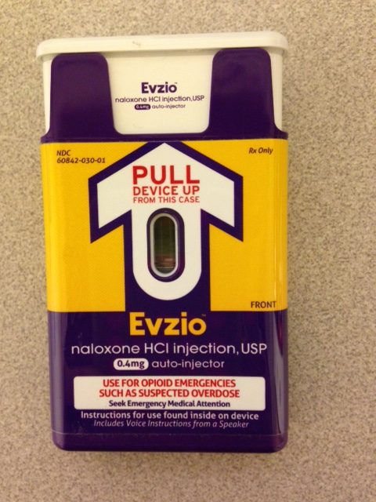
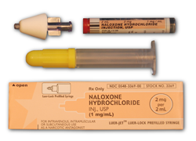

Slide 12
Outpatient Tapering Options
Gradual taper:
  5-10% decreases of the original dose every 5-28 days until 30% of the original dose is reached, then decrease by 10% of the remaining dose every 5-28 days
  You may elect to taper Extended release (ER) or Immediate release (IR) first, though I generally taper ER first and use IR for breakthrough pain
  Provide the patient a copy of the taper plan for reference and to help keep patient moving forward

Slide 13
Outpatient Tapering Options
Rapid taper:
  Daily to every other day reductions over 1-2 weeks as appropriate
Medication assisted taper:
  Adjuvant opioid withdrawal medications only
  Office based buprenorphine detoxification or maintenance transition
  Methadone maintenance treatment

Slide 14
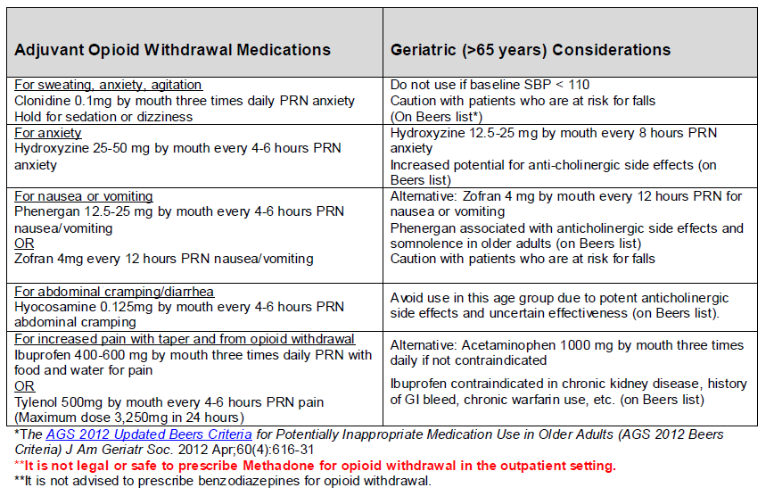

Slide 15
Medication Assisted Treatment
Some patients will be “unable” or intolerant of taper
  Methadone >30mg
  MED >200mg
  Long term use > 5 years
  Mental illness, distress intolerant, history of adverse childhood experiences, history of substance use disorder, weak social supports
Buprenorphine/naloxone is an important resource for these patients
Also consider interdisciplinary pain programs

Slide 16
Case 1: Immediate Risks
50 yo man on opioids for LBP x 5 years develops severe constipation that is not amendable to treatments. You decide the risks outweigh the benefit of him remaining on morphine ER 15mg BID
Taper Plan:
  Step 1: convert his morphine to IR and reduce it to morphine IR 7.5mg Q8H for 2 weeks
  Step 2: Reduce morphine IR 7.5mg BID for 2 weeks
  Step 3: Morphine IR 7.5mg daily for 2 weeks
  Step 4: stop morphine
Notes:
Learning points:
You can’t cut ER tablets in half – become short acting opioids if you do this
Even a relative low dose of morphine can take time

Slide 17
Case 1: Immediate Risks
What if that same 50 yo man on opioids for LBP x 5 years is prescribed fentanyl 75mcg/72 hours.
Taper Plan:
  Step 1: convert his fentanyl to a different opioid that is easier to taper like morphine ER or oxycodone ER. Ex. Morphine ER 30mg/30mg/30mg.
  Step 1: Morphine ER 30/30/15mg TID x 2 weeks – 1 mo
  Step 2: Continue in 10-20% reductions until done
Notes:
Learning points:
You can’t cut ER tablets in half – become short acting opioids if you do this
Even a relative low dose of morphine can take time

Slide 18
Case 2: Substance Use Disorder
50 yo male prescribed hydromorphone 4mg every 3 hours and fentanyl 50mcg patch for chronic pancreatitis. You detect alcohol on a routine urine drug screening, and he admits that he has relapsed on alcohol.
What do you do?
Decide that the risks greatly outweigh the benefit
Refer to detoxification from alcohol and opioids
Stop prescribing opioids immediately
Consider buprenorphine/naloxone, if alcohol abstinent

Slide 19
Case 3
28 yo female prescribed opioids for chronic abdominal pain. She states she has lost her opioid prescription for the third time. She has had two negative urine drug tests for the opioid that is prescribed and refuses to come in for a pill count.
You suspect diversion.
Check PDMP
Taper Plan: None. You stop prescribing opioids immediately.

Slide 20
Case 4: “Lost Generation” with therapeutic alliance
68 yo female with rheumatoid arthritis pain. She is prescribed a total of 350mg MED for the last 5 years with no adverse events. She is moderately functional. Your clinic has developed a new opioid policy stating that patients prescribed doses >120mg MED need to attempt an opioid taper. She is concerned that she might develop serious harms from her opioids.
Taper plan: Slow taper by 10% per month over a year to a safer dose. May elect to slow down the taper if she experiences periods of worsening pain and/or opioid withdrawal.
If her disease continues to generate active nociceptive pain not controlled with DMARDs, she may well be a candidate for long-term opioids, but at a safer dose.

Slide 21
Case 5: “Lost Generation” with Hopelessness
63 yo man with history of low back pain and severe depression after a work injury in 1982. He has not worked since and spends most of his day being sedentary. He has been unwilling to engage in additional pain modalities despite multiple offers. He is prescribed oxycodone IR 30mg every 4 hours. You have tried other opioids but he has not had improvements. He refuses an opioid taper and states he will seek another provider if you start to taper his opioids.
Taper Plan: Offer buprenorphine, subacute detox program, OR a 1 month rapid taper

Slide 22
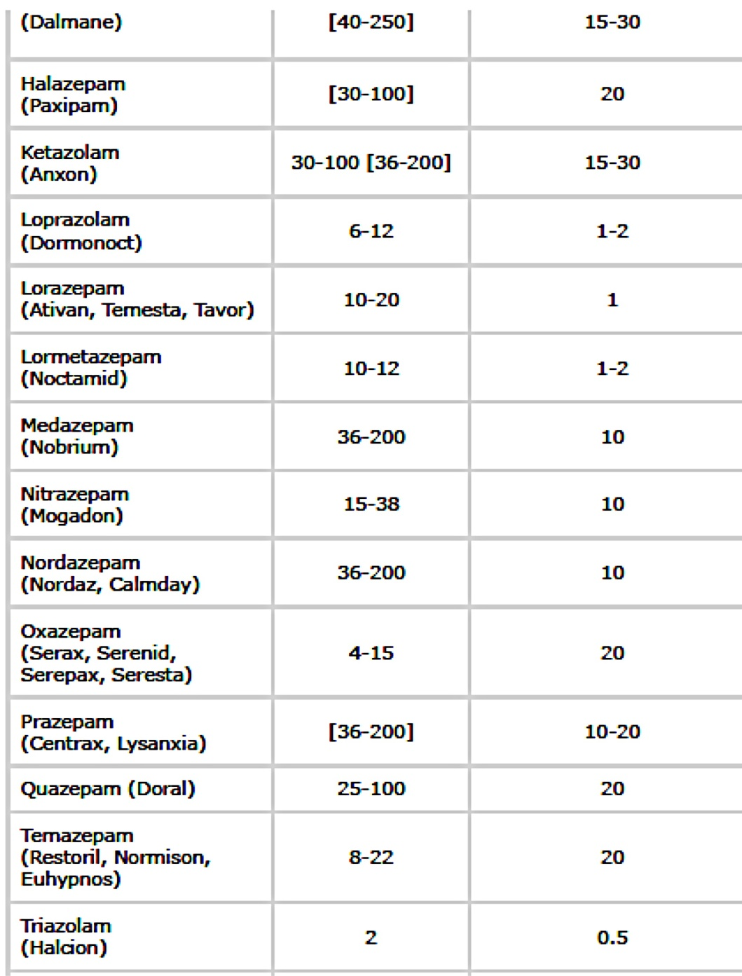
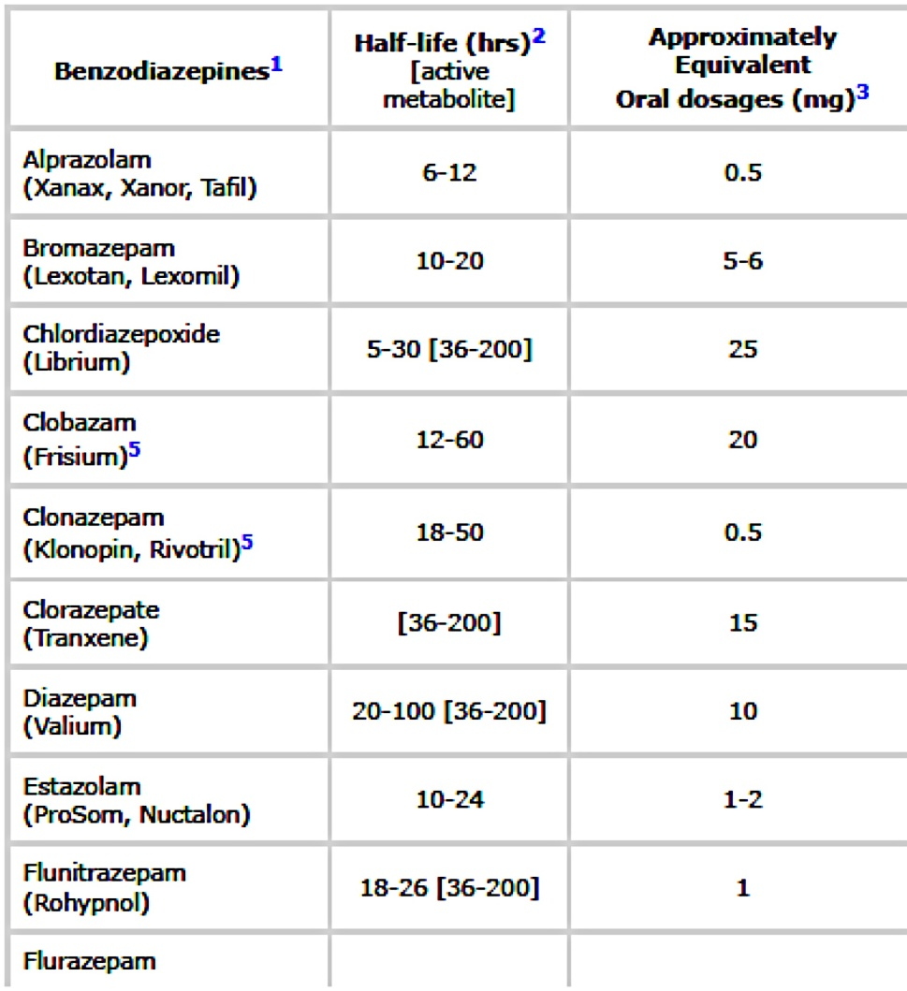
Tapering Benzos
Determine diazepam equivalent and prescribe 20% of calculated dose to prevent severe withdrawal
Dose reduce the usual benzodiazepine by 15-20% q1-2 weeks
Reduce diazepam by 15-20% q1-2 weeks
Once on only diazepam, reduce by 2 mg q 2 weeks until 5-10 mg, then reduce by 1 mg less q 1-2 weeks
Current Psychiatry 2013 September;12(9):55-56.

Slide 23
Benzodiazepine Taper Principles
Convert to a longer acting benzo, if needed
Timeframe depends on the indication for taper
Rapid tapers can safely and effectively occur over 10-14 days, but may elect inpatient detox
Elective benzo tapers will probably need to occur over a 6 month period
Notes:
Do not convert to phenobarbital without getting addiction medicine involved

Slide 24
Withdrawal adjuvant medications
Valproic Acid 250mg TID or Carbamazepine 200-800mg daily
  Continue for 2-4 week post complete cessation
Propranolol 20mg TID-QID
Clonidine or Tizandine
Hydroxyzine
Trazodone for sleep

Slide 25
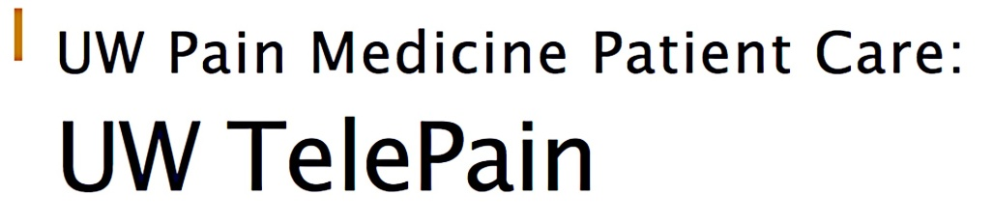




http://depts.washington.edu/anesth/care/pain telepain/index.shtml
www.coperems.org
www.scopeofpain.com
www.pcsso.org
www.pcssmat.org

Slide 26
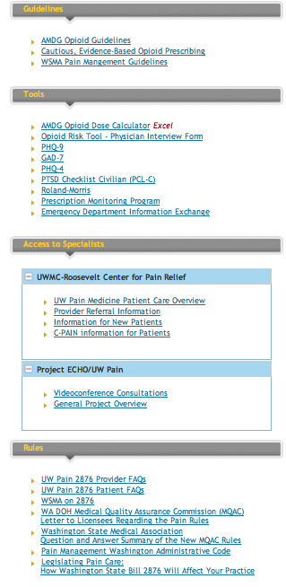
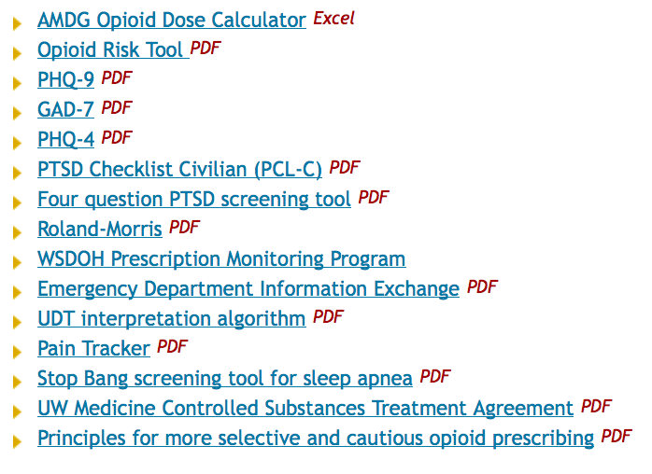

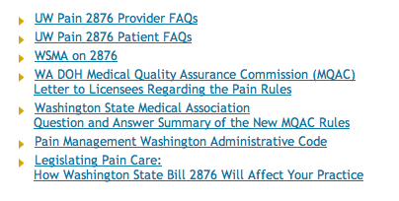
University of Washington
PAIN PROVIDER TOOLKIT
http://depts.washington.edu/anesth/care/pain/index.shtml

