Slide 1
Medication Assisted Treatment for Opioid Use Disorders
Melissa Weimer, DO, MCR
Assistant Professor of Medicine, OHSU
Medical Director, CODA, Inc.

Slide 2
Learning Objectives
Understand the basis for medication assisted treatment and how it fits into one model of addiction treatment Understand the unique properties of methadone, buprenorphine, and naltrexone for opioid use disorder treatment

Slide 3
Treatment Options for Opioid Use Disorders
Self-help groups
Detoxification +/- Medication Assisted Treatment (MAT)
Outpatient treatment +/- MAT
Residential treatment +/- MAT
MAT = Methadone, Buprenorphine, or Naltrexone

Slide 4
Medication Efficacy For Opioid Use Disorder
 | Treatment Program Retention | Opioid Misuse | Criminal Activity
Methadone | ⬆ (n=3)ª | ⬇ (n=6)ª | No Effect (n=3)ª
Buprenorphine | ⬆ (n=4)^{b} | ⬇ (n=2)^{b} | No effect (n=2) ª
PO NTX | No effect (n=2)^{c} | ⬇ (n=4)^{c} | ⬇ (n=2)^{c}
XR NTX | ⬆ (n=2)^{d} | ⬇ (n=3)^{d,e} | ⬇ (n=1)^{e}
ªMattick RP, et al. Cochrane Database Syst Rev 2011;
^{b}Mattick RP, et al. Cochrane Database Syst Rev 2013;
^{c}Minozzi S, et al. Cochrane Database Syst Rev 2011;
^{d}Krupitsky E et al. Lancet. 2011, Comer SD et al. Arch Gen Psychiatry 2006, ^{e}Lee J et al, NEJM, 2016.
Notes:
Similar to the other table,

Slide 5
Opioid Activity Levels
Full Agonist: Methadone
%
Mu Receptor Intrinsic
Activity
100
90
80
70
(“How High”)
60
50
Partial Agonist: Buprenorphine
40
30
20
10
Antagonist : Naltrexone
0
no drug
low dose
high dose
Drug Dose
(“How Much”)
Notes:
1. Opioid Mu Receptor instrinsic activity varies widely. Increasing full agonist dose produces increasing mu opioid receptor specific activity. Until maximum opioid agonist effects are achieved and no further effects can be produced, even by giving more drug.
2. Opioid antagonists bind and occupy mu opioid receptors but result in no specific intrinsic activity regardless of dose
3. Like full agonists, partial agonist drugs produce increasing mu opioid receptor specific activity at lower doses. At higher doses, even when partial agonist drug completely binds all mu receptors. Maximum opioid agonist effect is never achieved

Slide 6
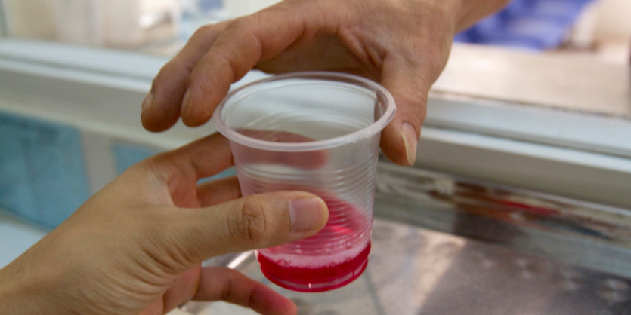
Methadone Maintenance Therapy
Full agonist with long elimination half-life
Once daily dispensing in a federally-qualified methadone clinic by an RN/LPN
Reduces euphoria of subsequent opioid use
Specific Eligibility Criteria
Typical effective dose range 60-90mg/day*
Contingency management – Take home doses (NTE 28 days)
Integrated individual and group counseling
*higher for pregnant patients
Notes:
It does not significantly decrease mortality or criminal activity
Higher doses of methadone are more effective than lower doses (<20mg) – Johnson NEJM
Effective to
Increase retention in treatment
Reduce use of opioids
Reduce human immunodeficiency virus (HIV)

Slide 7
Methadone: Pros/Cons
Pros
Increased retention in treatment
Decreased opioid use
Decreased HIV transmission
Highly structured treatment
Psychiatric comorbidity
Polysubstance use
Frequent relapses
Gold standard for OUD in Pregnancy
Some analgesic benefit
Cons
QTc prolongation
High overdose risk
Many drug-drug interactions
Benzodiazapines
HIV meds
Seizure medications
Polysubstance use
Daily dosing

Slide 8
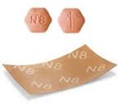
Buprenorphine (subutex™) /naloxone (Suboxone™) (4:1 combination)
Partial opioid agonist (plateau effect)
Long half-life
Typically once daily, but BID or TID is safe
24mg usually the highest effective dose
Less euphoric effect than other opioids
Paired with antagonist (naloxone) to prevent abuse through injection
Office based prescribing with DEA waiver or “X license”
One day or online training
Treat up to 30 patients first year, then up to 100 patients
Notes:
Buprenorphine is an effective medication in the maintenance treatment of heroin dependence, retaining people in treatment at any
dose above 2 mg, and suppressing illicit opioid use (at doses 16 mg or greater) based on placebo-controlled trials.

Slide 9
Buprenorphine: Pros/Cons
Pros
Effective for pain and OUD
Increased retention in treatment
Low overdose risk
Office-based prescribing (OBOT)
Minimal drug interactions
Except benzos, etoh
No cardiac toxicity
Less neonatal abstinence syndrome compared to methadone
Cons
Training required to prescribe
Cost
Can complicate pain treatment
Potential for precipitated withdrawal
Can be diverted

Slide 10
Methadone Vs. Buprenorphine
Low dose Buprenorphine (2-6mg) was less effective than methadone in retaining people in treatment.
Buprenorphine (>7 mg/day) was not different from methadone (>40 mg/day) in retaining people in treatment or in suppression of illicit opioid use.
Mattick RP, Breen C, Kimber J, Davoli M. Buprenorphine maintenance versus
placebo or methadone maintenance for opioid dependence. Cochrane Database of
Systematic Reviews 2014, Issue 2.

Slide 12
Naltrexone: opioid antagonist
Two formulations approved in US
Oral Naltrexone (1984), 50mg once daily
Extended Release Naltrexone, (2010) Q 28 days
Blocks all Opioid receptors
Not controlled
Blocks euphoric effects of opioids
Also treats alcohol dependence
ER Naltrexone has important use in criminal justice
Notes:
PA, NP can prescribe it
Oral naltrexone had no effect on treatment retention, decreased opioid misuse
Vivitrol inc treatment retention and dec opioid use

Slide 13
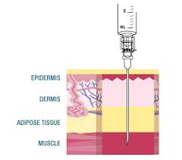
Extended release naltrexone

Slide 14
XR-Naltrexone for Opioid Use Disorder
Intramuscular injection lasts 28d
Efficacious compared to placebo:
Comer: 60 U.S. heroin users at 8 weeks¹
Krupitsky: 250 Russian heroin users at 24 wks²
Naltrexone ER: 45 (35.7%) vs Placebo 25 (22.8%)
RR 1.58, 95% CI (1.06 – 2.36), p = 0.0224
NNT 7.8
Fair quality study, high attrition, young white males only
¹ Comer Arch Gen Psych 2006, ²Krupitsky Lancet 2011, ³ Wang J Leuk Bio 2006, ⁴ Gekker Drug Alc Dep 2001, ⁵ Quin J Cell Biochem 2011
Notes:
Oral naltrexone improved non-drug use related impulse disorder such as compulsive sexual behavior
Pathological gambling
Kleptomania
Binge eating

Slide 15
Primary Outcome:
Median Time to
Relapse
10.5 vs 5 wks
HR 0.49
(95% CI 0.36-0.68)
P <0.0001
Lee, J, et al. NEJM, 374; 13. 2016

Slide 16
Naltrexone: pros/cons
Pros
Not controlled
Mid-level providers can prescribe
Lasts 28 days
Treats etoh and opioid use disorders
No ability to feel effects of opioids
Few drug interactions
Cons
Must be opioid free for 5-7 days
Can complicate pain treatment
May affect liver function
Pain at injection site
Cost
Overdose risk when dose wears off

Slide 17
Detox vs. Maintenance: Which is Better?
Multi-site trial of buprenorphine/nx for 653 patients with prescription opioid use disorder in 10 primary care clinics
Detox phase followed by maintenance phase for those who relapse
“Success” = minimal or no use on UDS & self-report
Success at 12 Weeks:
Detox Phase: | 6.6%
Maintenance Phase: | 49.2%
¹ Weiss Arch Gen Psych 2011

Slide 18
Treatment Retention:
Buprenorphine Detox vs. Maintenance
20
Maintenance: 75% Abstinent at 1 year
15
Remaining in treatment (nr)
10
Detox: 0% Abstinent at 1 year
5
HR = 58.7, p .0001
0
0
50
100
150
200
250
300
350
Treatment duration (days)
Kakko, Lancet 2003
Notes:
15/20 patients receiving bup maintenance were successfully retained in care, whereas all 20 patients assigned to bup detox taper failed treatment within the first 60 days, resulting in a Cox Proportional Hazard ratio of 58.7. All placebo patients who dropped out did so following relapse to drug use (as determined by urine testing). 75% of UDS were negative over the course of 1 year in the maintenance therapy group.

Slide 19
Common Pitfalls in Primary Care
Communication difficulties
With patient and addictions providers
Knowledge gaps about MAT
Use of methadone to treat opioid use disorder outside of a methadone clinic
Referral to methadone clinics for patients with pain
Prescribing drugs that interact with MAT

Slide 20
Questions? weimerm@ohsu.edu Twitter @DrMelissaWeimer
www.coperems.org
www.scopeofpain.com
www.pcsso.org
www.pcssmat.org

