Slide 1

Implementation of Pain Programs within Coordinated Care Organizations
May 28, 2015
Mark Altenhofen, MS
Chief Executive Officer

Slide 2
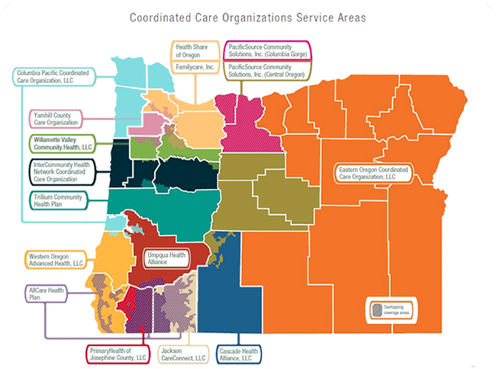
CPCCO
Astoria,
Scappoose,
& Tillamook
North Coast
Pain Clinic
EO CCO
Pendleton,
La Grande,
& Baker
Persistent Pain Program
YCCO
McMinnville
Pain Programs TBA
JCC & AllCare CCO’s
Medford
Pain Resiliency Program

Slide 3
Barriers to Expanded Use of Non-Opioid Therapies for Persistent Pain
Barriers
Communication
Understanding Pain
Culture, Community & Family Systems
Financial
Care Transitions
Access to Treatment
Complexity
Peer to Peer

Slide 4
Overcoming Barriers to Expanded Use of Non-Opioid Therapies
for Persistent Pain
Pain Program (EBT)
Link to Mental Health Treatment
Medical – Pain Education Standards / Rx Guidelines
Link to Case Management Resources
Financial Model – Case Rate vs. Fee For Service
Link to Chemical Dependency Treatment
Referral Workflow / Communication
Community Alignment, Messaging & Support
Peer to Peer Support Group (Managed by Pain Program)

Slide 5




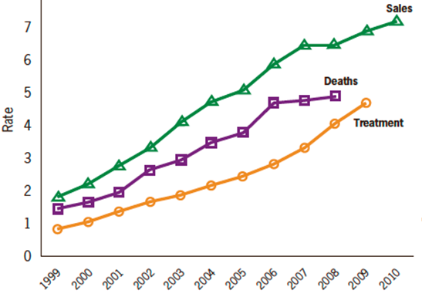

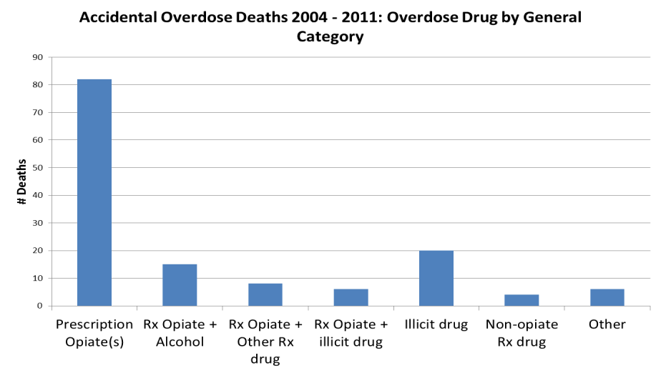
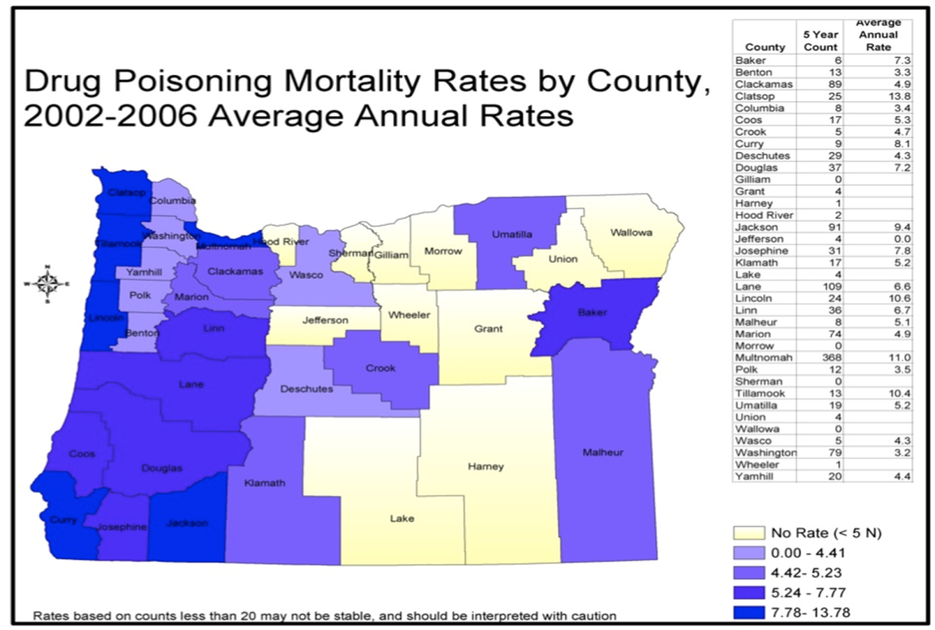


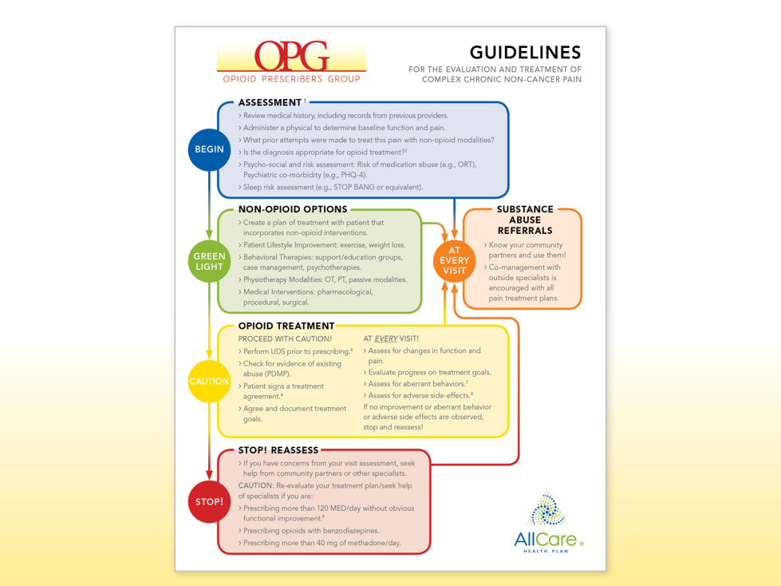
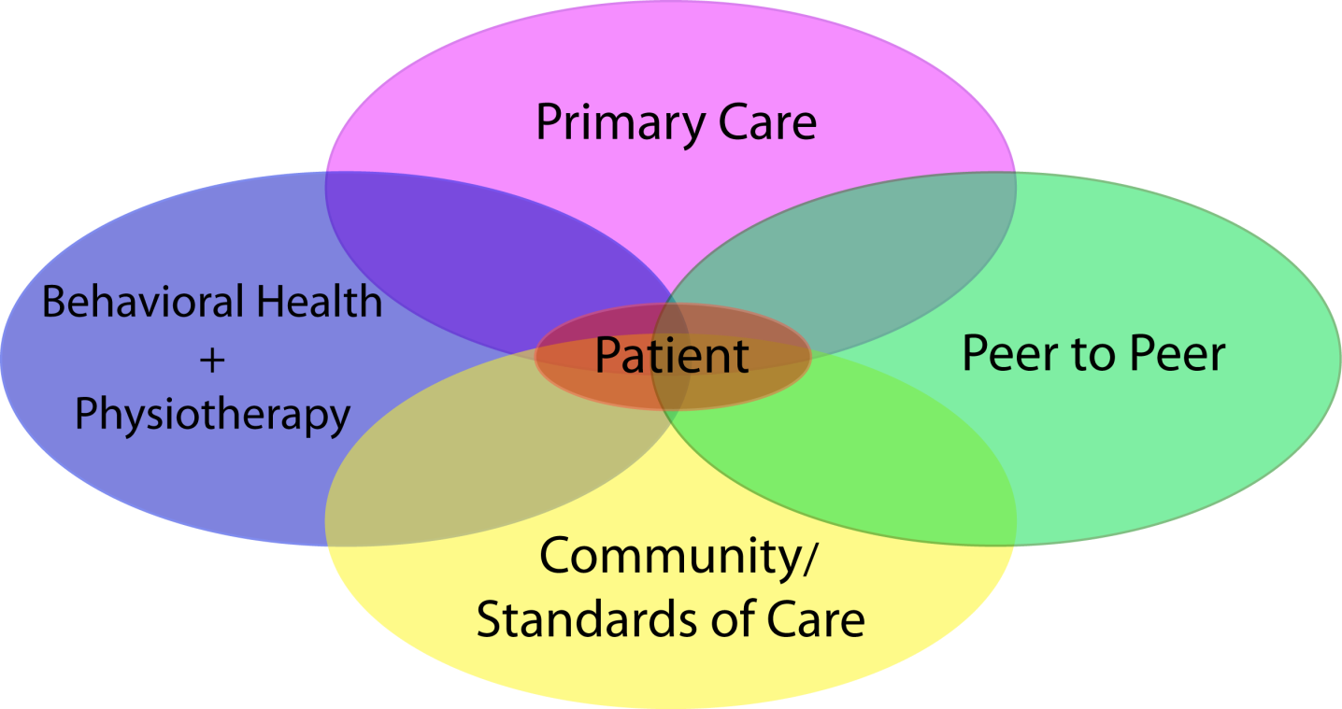
Pain Resiliency Program
Clinical Model for Persistent Pain
LEAD: Mark Altenhofen, MS, Oregon Pain Advisors, LLC, Consultant for Jackson Care Connect
mark@painadvisors.com
LEAD: Anne Alftine, MD, Director of Clinical Integration for Jackson Care Connect alftinea@careoregon.org
John Kolsbun, MD, Medical Director, AllCare CCO jkolsbun@mripa.org
Jim Shames, MD, Medical Director, Jackson County Health and Human Services ShamesJG@jacksoncounty.org
Project Goals
Decrease opiate prescriptions for chronic pain
Increase patient function and self efficacy
Educate, train, & provide tools for providers
Educate & offer support for chronic pain patients
Appropriate system utilization
Work with Community Oregon Pain Guidance Group
Background
Opioid Issues:
Increasing death and addiction rates
No standards of care
Lack of efficacy for chronic opioid therapy
Weak provider training
Lack of coordinated care
Opiate Rx
National Rates
Project Measures
Key measurements, milestones, benchmarks
  Clinical -- Outcomes to improve patient function
  – Oswestry, self efficacy, fear of movement, PHQ-9
  Financial – Reduction in costs or cost
  offsets associated with treatment.
  Utilization – Alignment with appropriate
  healthcare resources.
  Utilization – Appropriate
  referrals to MH & CD Tx.
  Providers -- Training & standards of care.
Accidental Overdose Deaths 2004-2011
Overdose Drug by General Category
Jackson County Rates
Progress to Date/Next Steps
Chronic Pain Issues
Established to date:
OPG prescribing & pain
treatment guidelines
120 Morphine Equivalent Dose (MED) policy
Provider training on guideline
implementation
Pilot Phase – Pain Resiliency Program (1 year)
Peer to peer program for chronic pain
Community outreach
Provider training on referral
and pain program workflow
Implementation of case rate reimbursement
Ongoing provider training & community outreach
Pain Resiliency Program sustainability
Simple solutions for a complex issue.
Lack of biopsychosocial programs (interdisciplinary or multidisciplinary)
Poor understanding of opioids and pain (providers, individuals, community)
Comorbid PTSD, depression, anxiety
Comorbid substance abuse

Slide 6
Pain Resiliency Program Workflow
Jackson Care Connect CCO / AllCare CCO
8 Week Interdisciplinary Group Program; No Rx
Pain School - Behavioral Health Consultant w/Educational & CBT Focus
Movement Therapy – Yoga Therapist with Chronic Pain Training
PCP Referral
(ED & MidLevel)
Group Orientation;
1:1 Intake;
Pre-Program
Assessments
Pain School
2 hrs /wk
Yoga
1 hr/wk
8 Weeks
Graduation;
Post Program Assessments;
Outcomes
to PCP
Feedback to PCP

Slide 7
CCO Project Start-Up
  Opiate Rx Guidelines / Standards of Care
  Prepare for pain program start-up. Pilot 6 – 12 Months
  Secure funding for pilot from Transformation or Flex Spend $’s via CCO; Move to case rate billing after pilot phase.
  Educate providers (especially PCPs) on PAIN + program implementation & access.
  Inclusion of chronic pain education for communities (law enforcement, families/support persons).
  Communications Plan / Public Announcements via Radio & Newspaper.
  CCO Board, CAP, & Pain Subcommittee meetings.
  Partnerships – Community Mental Health, CCO, Hospital / Health System, Primary Care, Private Insurance, Chemical Dependency, Non-Emergent Transportation Providers.

Slide 9
North Coast Pain Clinic
Program Exit Survey Results (Groups 1-7)

Slide 11
Q & A

