Slide 1
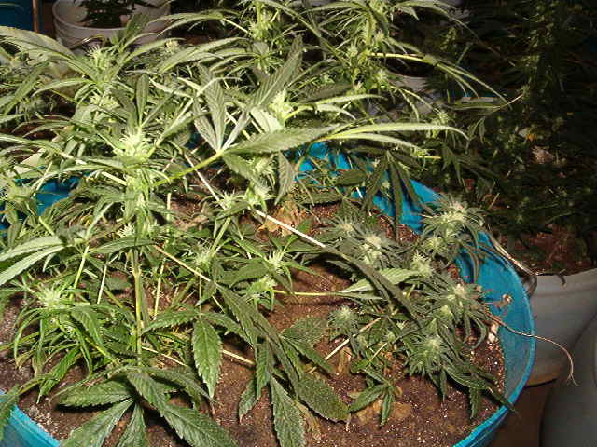
Marijuana: Is it appropriate for the treatment of persistent pain?
Launette Rieb
MD, MSc, CCFP, FCFP, dip ABAM
Clinical Associate Professor, UBC
Thoughtful Approach to Chronic Pain. Medford, Oregon, May 28-30, 2015

Slide 2
Faculty/Presenter Disclosure
Faculty: Launette Rieb
Relationship with commercial interests:
No commercial interests

Slide 3
Disclosure of Commercial Support
No financial support or in-kind support for this program
No potential conflicts of interest for Dr. Rieb

Slide 4
Mitigating Potential Bias
There is no bias to mitigate due to commercial interest
Any “bias” I may have comes from treating thousands of people with addiction and pain conditions
Notes:
Any “bias” I may have comes from treating thousands of people with addiction and pain conditions

Slide 5
Learning objectives
Highlight cannabinoid neurochemistry
Summarize adverse health risks
Overview literature on cannabinoids for medical use, focus on pain
Review new CFPC guidelines for dried cannabis “prescribing” including indications, contraindications

Slide 7
Parallel with Tobacco
Free of legislation
Criminalization
Medicalization
Decriminalization
Legalization and taxation
Health consequences studied
Leading cause of preventable death
Campaigns to curtail initiation and use

Slide 8
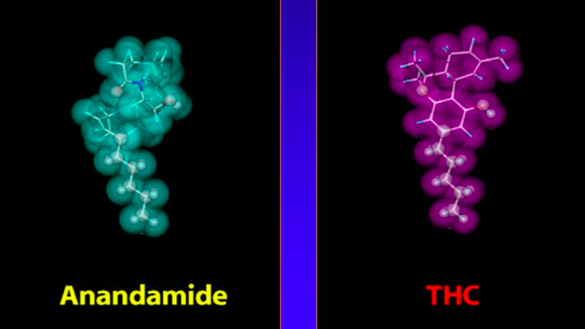
Endocannabinoids
Endogenous cannabinioids:
Anandamide and others
CB1 receptors central
CB2 peripheral
Plant makes THC,
binds to receptors
Notes:
Role in infant bonding, regulates dopamine (DA), can influence sleep, appetite, pain, immune function
Endogenous Cannabinoid Agonists
N-arachidonylglycerol (Anandamide) = BLISS
Less potent and shorter acting than ∆⁹-THC
2- arachidonylglycerol and Palmitoylethanolamide
Cannabinoid Receptors
CB1-Located throughout CNS (hippocampus, cortex, olfactory, basal ganglia, cerebellum, & spinal cord). Recently discovered in the placenta
CB2 - Located peripherally (spleen, B lymphocytes, & macrophages)

Slide 9
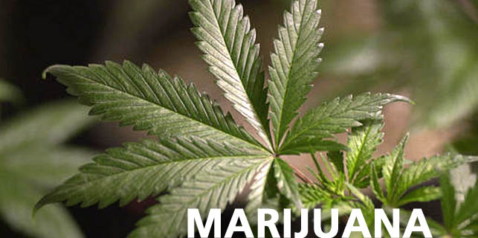
Cannabis
Cannabis sativa class - hallucinogen
400+ chemicals
70+ cannabinoids
∆-9-Tetrahydrocannabinol (“THC”)
Binds to CB1 and CB2 receptors
↑Dopamine – which reinforces use
Stimulant & depressant
Psychotropic
Notes:
Paranoia, delusions, hallucinations

Slide 10
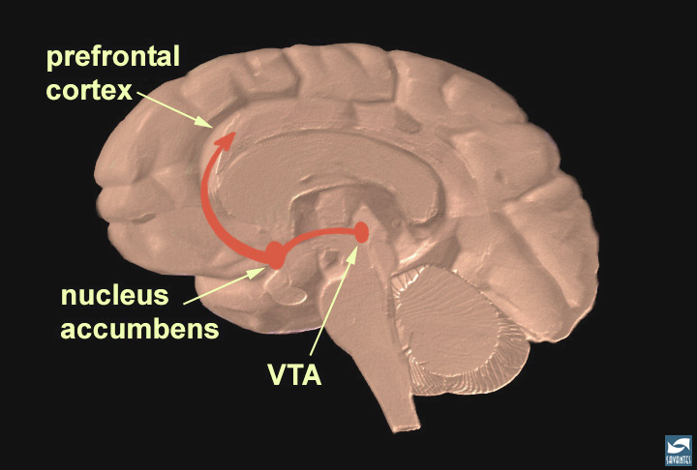
Remember
All mood altering substances can reduce pain while intoxicated
All substances (including pain medications) that cause dopamine release in the misolimbic system can be overvalued – even in the absence of true addiction – hence the emotional attachment around discussing opioids, cannabinoids, benzos, etc. with patients

Slide 11
THC vs CBD
Cannabidiol (CBD) produced by plant
Protective against psychosis, anxiolytic
As the marijuana THC content goes up, the CBD content goes down
In 1960s marijuana had 2-3% THC and CBD
Now THC can be up to 25% & CBD near 0
Some strains have high CBD and low THC

Slide 12
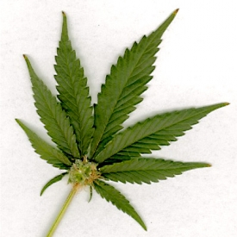
Increasing Potency of Marijuana
(% Δ-9 THC)
%
Notes:
Looking at daily use it has been reasonably stable over time, but this white line shows over the past 10 years the potency of marijuana appears to have increased disproportionately (based on the average cannabinoid concentration by year). I can’t comment on any potential impact, whether users are titrating their intake or actually absorbing much higher concentrations of THC but it’s certainly noteworthy and warrants investigation

Slide 13
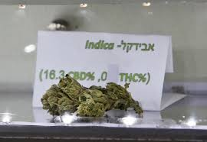
THC vs CBD
Notes:
There is no testing or quality assurance in place with dried cannabis typically, just the claims of the seller, unlike in the pharmaceutical industry which is regulated. Gov’t agencies have regulated THC levels.

Slide 14
Cannabinoids
Nabilone – synthetic delta 9 THC
Dosing 0.25 - 4mg/d divided tid to qid
Does not show up on urine drug screen
Approved in Canada: Chemotherapy induced N+V
Nabiximols – plant extract of delta-9-tetrahydrocannabinol 2.7 mg and cannabidiol 2.5 mg in an oro-mucosal spray
Dosing 1-12 sprays/d divided tid to qid
Approved in Canada and UK for advanced cancer pain, MS associated pain and spasticity
Notes:
Nabilone (Cesamet) – synthetic cannabinoid – antiemetic
Delta-9-tetrahydrocannabinol-cannabidiol (Sativex)
Nabiximols (Sativex) (Delta-9-tetrahydrocannabinol-cannabidiol, oro-mucosal cannabinoid

Slide 15
Cannabiniods, cont’d
Dronabinol - delta-9-THC
2.5-20 mg/d in divided dosing tid to qid
Approved in Canada: For chemotherapy induced N+V, and for anorexia associated with HIV/AIDS
Ingested marijuana
Usually about 1/3 more than smoked, baked
Harder to titrate than smoked, but longer lasting
Smoked marijuana = “dried cannabis”
Patients’ use huge range – few puffs to many grams/d
This is why guidelines have been developed
Health Canada exemption, many states in US have marijuana for medical purposes exemptions
Notes:
Dronabinol (Marinol) – distilled natural THC – no longer in Canada?

Slide 16
Pharmacokinetics
Inhalation
Peak effect 10-30 min, duration 2-3+ h
Oral Ingestion
Peak effect 1-2 h, duration 4-6+ h
First pass hepatic metabolism
Highest [THC] found in heart & fat
Metabolism by cytochrome P450
Half-life 2-60 h
Excretion 1/3 urinary, 2/3 fecal
UDS: Single use 5-7+ d, chronic use 45+ d
Notes:
Longer residual effects

Slide 17
Adverse Health Effects of Marijuana Use - Volkow N, et al. 2014
Short term:
Impaired memory, making it difficult to learn
Impaired motor coordination, impairing driving, ⬆ injury
Altered judgment, ⬆ risk of STIs,
Paranoia and psychosis in high doses
Long term:
Addiction
Altered brain development
Poor educational outcomes, cognitive impairment, ⬇ IQ
Diminished life satisfaction and achievement
Chronic bronchitis
⬆psychotic disorder risk (including schizophrenia)
Notes:
Volkow N, et al. NEJM (2014)Jn,370;23:2219-2227

Slide 18
Adverse Health Effects -details
Acute
Dry mouth, conjunctival injection
↓BP, ↑HR, arrhythmias
Decreased exercise time to onset of angina (Aronow, 1974)
Attention, motivation, memory, false novelty, paranoia, derealization, hallucinations
THC ↑anxiety, acute psychosis; CBD may ↓anxiety (Fusar-Poli 2009)
Altered depth perception, coordination, driving impairment (Robbe, 1998)
Notes:
Case reports of arrhythmias. Also evidence of gynecomastia, lowered testosterone, and interference with LH and FSH.
Decreased exercise time to onset of angina (MJ 48%, tobacco 23%, placebo 8%) [Aronow et al. NEJM 1974;291:65-67]
cancer from 1 joint-year of MJ smoking (8%) was similar to 1 pack-year of cigarette smoking (7%). [Aldington et al. Eur Respir J 2008;31:280-286]
Increased tar (3x) & carbon monoxide (5x) delivery compared to cigarettes
MJ smoke contains carcinogens (nitrosamines, phenols, aldehydes, polyvinyl chlorides, benzopyrene)
Cytologic changes- metaplasia, decreased tumoricidal activity of alveolar macrophages
A US study of youth in treatment for cannabis use disorder showed the vast majority obtained their dried cannabis from people with a medical marijuana exemption/prescription

Slide 19
Adverse Health Effects
Chronic
↑Risk of COPD (Tan, 2009)
Brain changes: Heavy daily users 5+ joints/d:↓hippocampal and amygdala volume (Yucel, 2008)
Lowers IQ: If initiation prior to age 18 - IQ does not recover when detoxed; if adult initiation, can normalize, continued use can add to neurocognative decline with aging (Meier, 2012)
↑Risk of psychotic disorder - dose dependent, age dependent, genetically influenced (VM=2x, VV=10x), CBD may be protective (Andereasson 1987, and Zammit 2002, Henquet 1995, Caspri, 2005)
Hormonal effects – ↓testosterone, LH and FSH
↑Risk of cannabis use disorder = addiction (9% users, 17% if began <age 18, 25-50% of daily users)
↑Risk of diversion

Slide 20
Addiction: About 9% of users may become dependent ~1 in 6 who start in adolescence, and 25-50% of daily users
Estimated Prevalence of Dependence Among Users
*
*
(NESARC data collected 2001-2005, Lopez-Quintero et al., 2011)
* Nonmedical Use Source: Anthony JC et al., 1994

Slide 21
Source of Marijuana* among 12th Graders in 2012 and 2013, by State Policy
%
*Categories not mutually exclusive
** Statistically significant difference
Notes:
B021. Where did you get the marijuana you used during the last year? (Mark all that apply)
Overall 3.1% said they got their mj from own mmj prescription- split to 5.5 in mmj state vs 1.6 in non-mmj state (?).
B021a. Did you get any of the marijuana you used during the last year from someone else's medical marijuana prescription?
Overall 18.4% said they got the mj they used from someone else’s prescription – over 1/3 of those in mmj states said yes to this question compared to less than 9% in non-mmj states

Slide 22
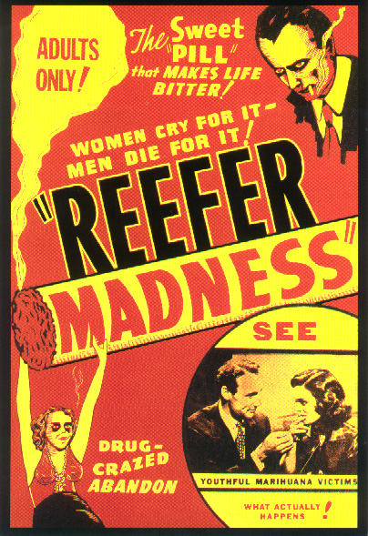
Notes:
Don’t mean to be alarmist

Slide 23
Estimated Relative Risk of Death from Illicit Drugs
Opioids | 14.7
Cocaine | 4.7-7.6
Amphetamines | 6.2
Cannabis | 1
(Dagenhardt & Hall, 2012)
Note: Cannabis deaths likely underestimated (e.g. motor vehicle accidents & respiratory disease)

Slide 24
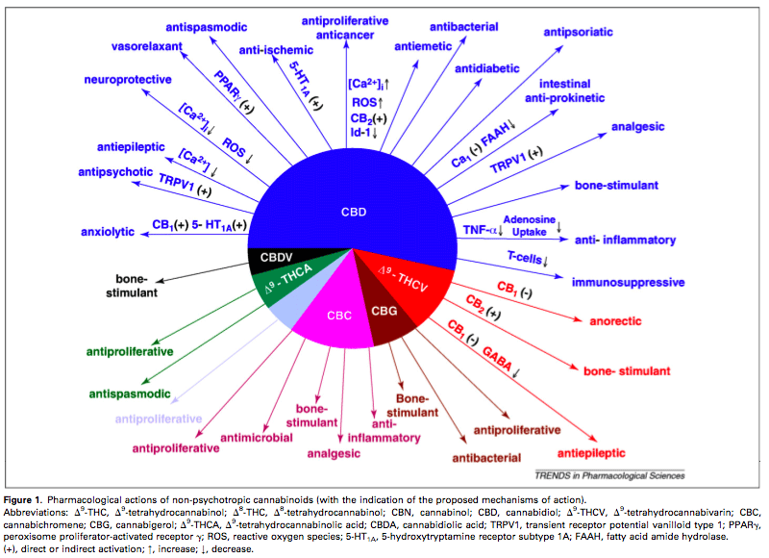

Slide 25
Potential Medical Uses
Antiemetic: Effective chemo N+V (Sallan 1975); beware of rebound N +V or hyperemesis with use
Appetite stimulant in HIV/AIDS: evidence “lacking” on Cochrane Review (Lutage 2014)
Antispasmodic for MS: Reduced patient reported spasticity with oral whole plant extract (nabiximols)(Wade 2010, AAN.com/guidelines))
Anticonvulsant and for HD: insufficient evidence (AAN.com/guidelines)
Glaucoma: Modest ↓ intraocular pressure of short duration (2-4 h), followed by rebound hypertension. Chronic use leads to tolerance of IOP effect (Jones et al,1981)
Topical synthetic cannabinoids may decrease IOP (Porcella, 2001)
Notes:
Inhaled evidence for antispasmodic largely anecdotal
Animal studies show both pro and anti convulsant properties

Slide 26
Analgesia
Possible mechanisms:
Via CB1 and CB2 receptor activation modulates nociceptive responses (Chiou, 2013)
Amygdala activity contributes to the dissociative effect of cannabis on pain perception (Lee, 2013)
Notes:
Also note that any mood altering drug alters pain perception during euphoria, including alcohol, cocaine, etc.

Slide 27
Systematic Review and Meta-analysis of Cannabis Treatment for Chronic Pain
Martin-Sanchez et al. Pain Medicine Vol 10 (8) 2009: 1353-1368
Double blind RCTs comparing any cannabis preparation to placebo in pts with chronic pain (>6mo) published to Feb 2008
18 studies included
Notes:
LR – Nabilone, Cessemet, Sativex (CB2 receptor agonist supposedly), smoked, ingested
I like this study since it is how our pts use it – every which way. AND FOR EVERY TYPE OF PAIN

Slide 28
Meta-analysis of cannabis for CP
Baseline=0, scale: -10 to +10
Efficacy -0.61 SMD (-0.84 to -0.37), modest
Altered perception OR: 4.51, NNH: 7
Altered motor fxn, OR: 3.93, NNH: 5
Altered cognitive fxn, OR: 4.46, NNH: 8
“Beneficial effects may be partially (or completely) offset by potentially serious harms”
Notes:
A positive # would indicate more pain a negative score less pain. The pain drop was incredibly modest – and would not be considered clinically significant (usually a change of 2 would be needed). This is only about 0.5 or less on a 10 pt scale. This is far less than an NSAID or an opioid = 2-3 pts drop on a 10 pt scale.
Altered perception = blurred vision, hallucinations, tinnitus, disorientation, confusion, dissociation, and acute psychosis.
Events of altered motor function = speech, ataxia, muscle twitching, and numbness.
Events affecting cognitive fxn = Impaired memory, disturbance in attention, disconnected thought.
All of the above mentioned categories and each specific area had adverse changes overall.
Nb. In the long term trials (4 studies of 4 to 5 weeks) the cases of acute psychosis on naïve subjects ranged from 36.3% to 80%!!!!
None of the studies reported on the addictive effects of the agents used!! And pts were not followed after to see the effect of use of the substance on addictive behaviors.
Eleven of the studies provided no information on prior use of cannabis.
Dearth of studies comparing cannabis to gold standard treatments in RCTs
SMD = standard mean difference scored as 0 = baseline then pain decrease to negative 10, or increase to positive 10 (negative value favors cannabis as pain relieving)
There may be better efficacy outcome in studies with clear neuropathic pain only but these usually don’t detail side effects and are often short term studies.
May be a better result for MS – approved in Canada (LMR)
Efficacy -0.61 SMD (-0.84 to -0.37), modest
Altered perception OR: 4.51 (3.05-6.66), NNH: 7 (6-9)
Events of altered motor fxn, OR: 3.93 (2.83-5.47), NNH: 5 (4-6)
Events that altered cognitive fxn, OR: 4.46 (2.37-8.37), NNH: 8 (6-12)
“More risk than harm” was in the conclusion section.

Slide 29
Cannabis and Prescribed Opioids
Reisfield et al. Pain Medicine Vol 10 (8) 2009: 1434-1441
Systematic review of published studies on patients using opioids for CNCP that looked at aberrant drug related behavior and UDS results
Cannabis use is prevalent: 6.2 - 39% in pain pop.
Cannabis use - Significant association with present and future aberrant opioid related behaviors – diversion, cocaine in UDS, prescription forgery, no opioid in UDS
6x more likely to have the above behaviors than someone on opioids not using cannabis
Notes:
6x more likely to do the above behaviors than someone on opioids not using cannabis.

Slide 30
Neuropathic Pain - Review
Lynch ME, Cambell F. Cannabinoids for the treatment of chronic non-cancer pain: A systematic review of randomized trials. Br J Clin Pharmacol. 2011 Nov; 72(5); 735-744
Systematic review of RCTs on cannabinioids for CNCP 2003-2010
Of 80 studies, 18 meet PRISM criteria, 15 neuropathic pain, 766 people combined, 2 1/2 wks: 4 smoked cannabis, 7 oro-mucosal extracts, 4 nabilone, 2 dronabinol, 2 ajulemic acid. NNT varied.
Modest effect in neuropathic pain
Preliminary evidence of efficacy in fibromyalgia and rheumatoid arthritis
Notes:
4 smoked cannabis, 7 oromucosal extracts, 4 nabilone, 2 dronabinol, 2 ajulemic acid
NNT for 50% reduction varied
Most s/e transient: sedation, dizziness, dry mouth, nausea, decreased memory and concentration, headache, anxiety, paranoia, etc. SUD not studied (typically an exclusion criteria)
One person fractured leg attributed to the dizziness, and in some studies up to 10% pulled out due to s/e. Some studies reported improvement in sleep.

Slide 31
Neuropathic Pain - CPS
Moulin et al. Pharmacological management of chronic neuropathic pain: Revised consensus statement from the Canadian Pain Society. 2014
1st line: TCAs, SNRIs, gabapentinoids
2nd line: tramadol, other opioids
3rd line: cannabinoids – oromucal nabiximols
Note: Does not recommend smoked cannabis
4th line: methadone, lidocaine
Notes:
oromucal Nabiximols = Sativex

Slide 32
Diabetic Neuropathy
Snedecor et al. Systematic Review and Meta-Analysis of Pharmacological Therapies for Painful Diabetic Peripheral Neuropathy. Pain Practice (2014)Volume 14, Issue 2, 167–184
Oro-mucosal nabiximols scored worse than placebo for pain relief

Slide 33
Neuropathic pain
Finnerup N, et al. Pharmacotherapy for neuropathic pain in adults: A systematic review and meta-analysis. Lancet-neurology (2015) vol 14, Feb. 162-172
Identified 9 trials of nabiximols in neuropathic pain and only 2 were positive
Thus the authors made a weak recommendation AGAINST use of cannabinoids for neuropathic pain

Slide 34
So what is the evidence for smoked cannabis?
5 RCTs on smoked cannabis
Total subjects = 180
Duration range 3-15 days
Subjects had severe neuropathic pain from MS or HIV or other causes
The trials compared smoked cannabis to placebo and had modestly positive results
One trial that compared smoked cannabis to dronabinol
dronabinol had a longer duration of analgesia

Slide 35
Dried Cannabis Guidelines from College of Family Physicians of Canada (CFPC):
Kahan M, et al. 2014
Disclaimer: Dried cannabis differs from prescribed products in that Health Canada has not reviewed data on its safety or effectiveness and has not approved it for therapeutic use. CMA and CMPA does not endorse its use. “Prescribe” with discretion or not at all.
Notes:
This situation puts family physicians in a difficult position: we are asked to authorize our patients’ access to a product with little evidence to support its use, and in the absence of regulatory oversight and approval.

Slide 36
Indications for smoked cannabis
Severe neuropathic pain, not responding to other treatments including oral cannabinoids
NOT indicated for MSK pain

Slide 37
Recommendation 3
Dried cannabis is not an appropriate therapy for anxiety or insomnia (Level II)
Notes:
To our knowledge, there have been no controlled studies to date on the use of dried cannabis in the treatment of anxiety disorders. There is, however, a strong and consistent association between cannabis use and anxiety and mood disorders, although causality has not been established.28-38 Acute cannabis use can trigger anxiety and panic attacks,39 and studies on 40 animals and human volunteers suggest that high doses of cannabis actually worsen anxiety. Cannabis use may worsen psychiatric impairment in patients with anxiety disorders.36,41,42
The tetrahydrocannabinol (THC) content of cannabis is associated with anxiety,41 though this relationship appears to be bidirectional.43,44 Physicians should consider the THC content of available cannabis and consider authorizing, if at all, only lower-strength strains for patients with anxiety.45 Regular users of cannabis might experience early symptoms of cannabis withdrawal, including an exacerbation of anxiety, when they abstain; withdrawal symptoms can ultimately be resolved through cannabis cessation.46
The evidence for using pharmaceutical cannabinoids in the treatment of anxiety and insomnia is stronger than the evidence for using dried cannabis. Small trials have demonstrated that oral nabilone improves sleep in patients with fibromyalgia or post-traumatic stress disorder.13,47 An oral extract of pure cannabidiol has been shown to relieve symptoms of social anxiety.48

Slide 38
Recommendation 4
Dried cannabis is not appropriate for patients who:
a) Are under the age of 25 (Level II)
b) Have a personal history or strong family history of psychosis (Level II)
c) Have a current or past cannabis use disorder (Level III)
d) Have an active substance use disorder (Level III)
e) Have cardiovascular disease (angina, peripheral vascular disease,
cerebrovascular disease, arrhythmias) (Level III)
f) Have respiratory disease (Level III) or
g) Are pregnant, planning to become pregnant, or breastfeeding (Level II)
Notes:
Patients under the age of 25 (Level II)
Youth who smoke cannabis are at greater risk than older adults for cannabis-related psychosocial harms, including suicidal ideation, illicit drug use, cannabis use disorder, and long-term cognitive impairment.4,33,49-52 IQ and psychosis.
Patients with current, past, or strong family history of psychosis (Level II)
Observational studies have demonstrated a consistent association between cannabis use in adolescence and persistent psychosis.53-60
Patients with current or past cannabis use disorder (Level III)
Pain patients with cannabis use disorder should be counseled to discontinue cannabis and be referred for addiction treatment.
Patients with an active substance use disorder (Level III)
Dried cannabis should not be authorized for any patient with a current problematic use of alcohol, opioids, or other drugs.
REV Final for review 2014 Aug 6 Page 12Patients with cardiovascular disease (Level III)
Cannabis use causes acute physiological effects such as hypertension, tachycardia, catecholamine release, and vascular constriction.61-64 There have been reports of young people suffering cardiovascular events shortly after smoking cannabis.65-67
Patients with respiratory disease (Level III)
Heavy cannabis smoking may be an independent risk factor for impaired respiratory function and chronic obstructive pulmonary disease.68,69
Use of smoked cannabinoids has been found to increase the risk of airflow obstruction and hyperinflation but has been less associated with macroscopic emphysema.70 The cannabis use was associated with increased risk of lung cancer71 and head and neck cancer.72 The respiratory symptoms associated with dried cannabis use include wheezing apart from colds, exercise- induced shortness of breath, nocturnal wakening with chest tightness, and early morning sputum production.73
The depth of inhalation and the length of time the breath is held are usually greater when smoking marijuana than when smoking cigarettes. This means exposure to the chemicals in the smoke is greater for cannabis than for tobacco cigarettes, even though the frequency of smoking may be less. Cannabis smokers, for example, end up with five times more carbon monoxide in their blood stream than tobacco smokers.71
Patients who are pregnant, planning to become pregnant, or breastfeeding (Level II)
Preliminary evidence links cannabis use during pregnancy to neurodevelopmental abnormalities in infants.74 Cannabis enters the breast milk and is contraindicated in women who are breastfeeding.

Slide 39
Recommendation 5
Authorized with caution in those patients who:
a) Have a concurrent active mood or anxiety disorder (Level II)
b) Smoke tobacco (Level II)
c) Have risk factors for cardiovascular disease (Level III) or
d) Are heavy users of alcohol or taking high doses of opioids or benzodiazepines or other sedating medications prescribed or available over the counter (Level III)
Notes:
Patients with current mood and anxiety disorders (Level II)
Caution should be used when authorizing cannabis for patients with current mood or anxiety disorders, for the reasons outlined in Recommendation 3. If patients with co-existing anxiety and neuropathic pain are authorized for cannabis treatment, i) the dose should be kept low to avoid triggering anxiety, ii) the provider should consider indicating low THC-content or cannabidiol- only (CBD-only) strains on the medical document, and iii) cannabis should be discontinued if the patient’s anxiety or mood worsens.
Tobacco smokers (Level II)
Even after controlling for tobacco smoking, cannabis smoking has been associated with lung cancer75 and chronic bronchitis. Patients who smoke tobacco should be strongly advised to use cannabis via vaporization rather than by smoking it.
REV Final for review 2014 Aug 6 Page 13Patients with risk factors for cardiovascular disease (Level III)
Physicians are advised to use considerable caution when authorizing dried cannabis for use by patients with risk factors for cardiovascular disease (see Recommendation 4e). The dose should be kept low, and the patient should be encouraged to take it through vaporization or the oral route rather than by smoking it.
Heavy users of alcohol, or taking high doses of opioids, or benzodiazepines (Level III)
Cannabis use can worsen the cognitive impairment caused by opioids, benzodiazepines, other sedatives, and alcohol.76 Patients taking dried cannabis should be advised to use alcohol in moderation, and physicians should consider tapering patients on high doses of opioids or benzodiazepines.77,78

Slide 40
Recommendation 8
Before signing a medical document authorizing dried cannabis for pain:
Conduct a pain assessment (Level II)
Assess the patient for anxiety and mood disorders (Level II)
Screen (including urine drug screen) and assess the patient for substance use disorders (Level II)
Notes:
The physician should ask the patient to rate the pain on a 10-point scale, and to describe the effect of the pain on daily activities, including sleep. The physician should also assess the patient’s mood. The physician should take a careful history of current and past substance use, including cannabis, alcohol, tobacco, prescription opioids and benzodiazepines, and illicit drugs such as heroin and cocaine. Several of the provincial medical regulators (the provincial licensing colleges) recommend a standardized tool to assess the risk of addiction; the CAGE-AID is one simple, validated tool81 available to physicians (Table 4). A urine drug screen is also advised, and the patient should be asked to read and sign a treatment agreement (Table 2).

Slide 41
Recommendation 10
Patients taking dried cannabis should be advised not to drive for at least:
4 hours after inhalation (Level II)
6 hours after oral ingestion (Level II)
8 hours after inhalation or oral ingestion if the patient experiences euphoria(Level II)
Notes:
Cannabis use prior to driving is an independent risk factor for motor vehicle accidents.82-86 Patients should be advised not to drive for a minimum of four hours after inhalation or a minimum of six hours after oral ingestion87; they should abstain from driving for a full eight hours if they experience euphoria.88
However, note that “Health Canada states that the ability to drive or perform activities requiring alertness may be impaired for up to 24 hours following a single consumption.”12

Slide 42
Harm Reduction Advice
Use vaporizer instead of joint or pipe
Much lower levels of carbon monoxide
Don’t mix with tobacco
Caution with alcohol, opioids, and other drugs
Don’t breath hold
Caution with edibles

Slide 43
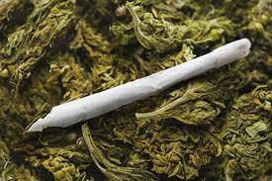
Average joint = 0.5 gm

Slide 44
****Dosing****
Dried cannabis 400-700 mg is the daily amount needed for analgesia according to the literature – you may choose not to go above this
Typical maximum amount would equal about 1 joint (500mg) per day, divided into a puff or two 3-4x per day
Highly tolerant individuals may require 1g and rarely 3 g /d (but not eligible if they have a cannabis use disorder - beware if a daily smoker prior to injury)
Start with 1 inhalation before bed, go slow
Notes:
400-700 mg are in the studies as daily amount needed for analgesia. Max typical would equal about 1 joint (500mg) per day. For cannabis tolerant individuals doses may need to go up to 1-3 mg /d. Note that I changed the total to 15 g from Mel’s 12 – so the math would add up. Above

Slide 45
****Dosing****
“Prescribing”
Document used should specify dose, percent THC, days, and amount dispensed:
“Dried cannabis 500 mg/day, 9% THC maximum, for 30 days, dispense 15 g”
Not clear if producers have to honor 9% THC direction but important to list
You can callback the patient for med check
Notes:
400-700 mg are in the studies as daily amount needed for analgesia. Max typical would equal about 1 joint (500mg) per day. For cannabis tolerant individuals doses may need to go up to 1-3 mg /d. Note that I changed the total to 15 g from Mel’s 12 – so the math would add up.

Slide 46
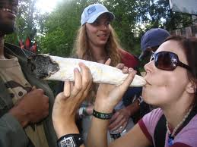

Slide 47
Monitoring
See patient – weekly to biweekly until dose established
Then monthly monitoring x three to six months before visits every 1- 3 months
Include an agreement, monitor for psychiatric symptoms, cannabis use disorder, functional changes
Do random urine drug screens for THC and other addictive substances

Slide 48
Discontinuation
Taper off
If no functional benefit is derived
If impaired in the office
If psychotic symptoms appear
If driving under the influence
If safety sensitive work or play impaired
If diverting

Slide 50
Thanks
Questions?

Slide 51
References
Key
Finnerup N, et al. Pharmacotherapy for neuropathic pain in adults: A systematic review and meta-analysis. Lancet-neurology (2015) vol 14, Feb. 162-172
Kahan M, Srivastava A, Spithoff S, Bromley L. Clinical Practice Review: Prescribing smoked cannabis for chronic noncancer pain: Preliminary recommendations. Can Fam Physician (2014) Dec. Vol 60: 1083-1090
Lynch ME, Cambell F. Cannabinoids for the treatment of chronic non-cancer pain: A systematic review of randomized trials. Br J Clin Pharmacol. 2011 Nov; 72(5); 735-744
Martin-Sanchez et al. A systematic review and meta-analysis of cannabis for chronic pain. Pain Medicine Vol 10 (8) 2009: 1353-1368
Volkow N, Baler R, Compton W, Weiss S. Adverse health effects of marijuana use. N E J Med (2014) June 370;23:2219-2227

Slide 52
References, cont’d
Other
Aldington et al. Eur Respir J 2008;31:280-286
Andreasson S et al. Cannabis and Schizophrenia: A longitudinal study of Swedish conscripts. The Lancet (1987) 2: 1483-1486 (Medline web of science)
Aronow et al. NEJM 1974;291:65-67
Caspi A, et al. Moderation of the effect of adolescent-onset cannabis use on adult psychosis by functional polymorphism in the catechol-O-methyltransferase gene: Longitudinal evidence of a gene X environment interaction. Biol psychiatry (2005) 57:1117-1127

Slide 53
References, cont’d
Merikangas KR, Stolar M, Stevens DE et al. Familial transmission of substance use disorders. Arch Gen Psychiatry 1998;55:973-9
Schubart C. et al. Cannabis with high cannabidiol content is associated with fewer psychotic experiences. Schizophrenia Research (2011) vol 130(1)216-221 www.ncbi.nim.nih.gov
Suzuki D. The downside of high. The Nature of Things (2010) www.cbc.ca/documentaries/natureofthings/2010/downsideofhigh/resources.html
Henquet C et al. The environment and schizophrenia: The role of cannabis use. Schizophrenia Bulletin (2005) vol 31(3), 608-612 (van Os’s group, open-source)
Zammit S et al. Self reported cannabis use as a risk factor for schizophrenia in Swedish conscripts of 1969. British Medical Journal (2002) 325: 1199
Zammit S et al. Cannabis, COMT and psychotic experiences. The British Journal of Psychiatry (2011)199:380-385
Tan et al. CMAJ. 2009;180:814-820

Slide 54
References, cont’d
Noyes . Clin Pharm & Therap. 1975;18:84-90
Johnson. J Pain Symptom Manag. 2010;39:167-179
Wilsey B. J Pain. 2008;9:506-521
Abrams DI. Neurology. 2007;68:515-521
Wade et al. Mult Scler 2010;16:707-14
Dagenhardt & Hall. Lancet 2012;379:55-70
Reisfield et al. The Prevalence and Significance of Cannabis Use in
Patients Prescribed Chronic Opioid Therapy: A Review of
the Extant Literature.Pain Medicine Vol 10 (8) 2009: 1434-1441
Lee M, et al. Amygdala activity contributes to the dissociative effect of cannabis on pain perception. Pain 154 (2013) 124-134
Sallen et al. N Engl J Med 1975; 293:795-7

Slide 55
References, cont’d
Selvarajah D, Gandhi R, Emery CJ, et al. Randomized placebo-controlled double-blind clinical trial of cannabis based medicinal product (Sativex) in painful diabetic neuropathy: depression is a major confounding factor. Diabetes Care.2010;33:128–130.
Snedecor SJ; Sudharshan L, et al. Systematic Review and Meta-Analysis of Pharmacological Therapies for Painful Diabetic Peripheral Neuropathy. Pain Practice, Volume 14, Issue 2, 2014 167–184
Elizabeth E Lutge^{1,2,*}, Andy Gray³, Nandi Siegfried⁴The medical use of cannabis for reducing morbidity and mortality in patients with HIV/AIDS. Editorial Group: Cochrane HIV/AIDS Group, Published Online: 30 APR 2013. Assessed as up-to-date: 30 JUL 2012 DOI: 10.1002/14651858.CD005175.pub3

Slide 56
References, cont’d
Fusar-Poli P et al. Distinct effects of {delta}9-tetrahydrocannabinol and cannabidiol on neural activation during emotional processing. Arch Gen Psychiatry. 2009 Jan;66(1):95-105
Yucel M. et al. Regional brain abnormalities associated with long-term heavy cannabis use. Arch Gen Psychiatry. 2008 Jun;65(6);694-701
Kahan M, Srivastava A, Spithoff S, Bromley L. Clinical Practice Review: Prescribing smoked cannabis for chronic noncancer pain: Preliminary recommendations. Can Fam Phys. 2014 Dec. Vol 60: 1083-1090
Wharry S. CMPA warns physicians of risks when prescribing marijuana. CMAJ 2002;166(1):83

Slide 57
References, cont’d
Andreasson S et al. Cannabis and Schizophrenia: A longitudinal study of Swedish conscripts. The Lancet (1987) 2: 1483-1486 (Medline web of science)
Caspi A, et al. Moderation of the effect of adolescent-onset cannabis use on adult psychosis by functional polymorphism in the catechol-O-methyltransferase gene: Longitudinal evidence of a gene X environment interaction. Biol psychiatry (2005) 57:1117-1127
Zammit S et al. Self reported cannabis use as a risk factor for schizophrenia in Swedish conscripts of 1969. British Medical Journal (2002) 325: 1199
Zammit S et al. Cannabis, COMT and psychotic experiences. The British Journal of Psychiatry (2011)199:380-385

Slide 58
References, cont’d
Merikangas KR, Stolar M, Stevens DE et al. Familial transmission of substance use disorders. Arch Gen Psychiatry 1998;55:973-9
Schubart C. et al. Cannabis with high cannabidiol content is associated with fewer psychotic experiences. Schizophrenia Research (2011) vol 130(1)216-221 www.ncbi.nim.nih.gov
Suzuki D. The downside of high. The Nature of Things (2010) www.cbc.ca/documentaries/natureofthings/2010/downsideofhigh/resources.html
Henquet C et al. The environment and schizophrenia: The role of cannabis use. Schizophrenia Bulletin (2005) vol 31(3), 608-612 (van Os’s group, open-source)

Slide 59
References, cont’d
Robbe H. Marijuana's impairing effects on driving are moderate when taken alone but severe when combined with alcohol. Human Psychopharmacology: Clinical and Experimental. Volume 13, Issue S2, pages S70–S78, November 1998. DOI: 10.1002/(SICI)1099-1077(1998110)13:2+<S70::AID-HUP50>3.0.CO;2-R
Jones et al. J Clin Pharm. 1981;21(supp 8-9):143S-152S
Porcella. European J Neuroscience. 2001;13(2):409-12
Taylor et al.Addiction.2000;95:1669-1677
Chiou LC, Hu SS, Ho YC. Targeting the cannabinoid system for pain relief? Acta Anaesthesiol Taiwan 2013;51: 161-70
Systematic Review: Efficacy and Safety of Medical Marijuana in Selected Neurologic Disorders also Summary of systematic reviews for patients and their families: Medical marijuana in certain neurological conditions. American Academy of Neurology. 2014 AAN.com/guidelines

Slide 60
References, cont’d
Kendler KS, Karkowski LM, Neale MC, Prescott CA. Illicit psychoactive substance use, heavy use, abuse, and dependence in a US population-based sample of male twins. Archives of General Psychiatry. 2000;57:261-9
Beal et al. J Pain & Symptom Management. 1995;10:89-97
Kosel. AIDS.2002;16:543-550. Abrams. Ann Intern Med.2003;139:258-266
Moulin et al. Pharmacological management of chronic neuropathic pain: Revised consensus statement from the Canadian Pain Society. Pain Res Manag vol 19 No 6; Nov-Dec, 2014
Meier A, et al. Persistent cannabis users show neuro-psychological decline from childhood to midlife. Proc Natl Acad Sci USA 2012;109(40):E2657-E2564

Slide 61
Refs cont’d 4 smoked cannabis studies
Wilsey B, Marcotte T, Tsodikov A, et al. A randomized, placebo-controlled, cross-over trial of cannabis cigarettes in neuropathic pain. J Pain (2008);9;506-21
Wallace M, Schulteis G., Atkinson JH, et al. Dose dependent effects of smoked cannabis on capsaicin-induced pain and hyperalgesia in healthy volunteers. Anesthesiology (2007);107:785-96
Wilsey B, Marcotte T, Deutsch R, et al. Low- dose vaporized cannabis significantly improves neuropathic pain. J Pain (2013);14:136-48
Cooper ZD, Comer SD, Haney M. Comparison of the analgesic effect of dronabinol and smoked marijuana in daily marijuana smokers. Neuropsychopharmacology (2013);38:184-92

