Slide 1
Brian Saling,DPT, OCS, COMT
Notes:
We have expanded the persistent pain program within rehab and now have 40 trained therapists throughout NW Oregon, working at 15 sites, including Newberg and Sherwood

Slide 2
What’s in it for you?
Help with your persistent pain patients!
Notes:
We know that treating patients with persistent pain is tremendously frustrating, and as the focus turns to taking your patients off of opioids, many physicians are looking for a better alternative, something that will actually help their patients with persistent pain.

Slide 3
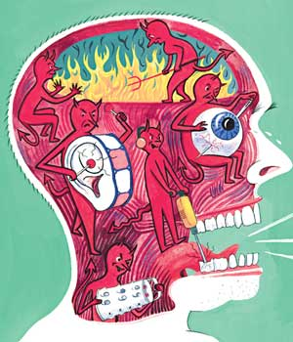
CONTEMPORARY UNDERSTANDING
Notes:
The organizing principle of our program is that pain is a product of the brain, and this is the where persistent pain needs to be addressed.
It’s at the brain that input gets altered, either increased or decreased. This is where persistent pain largely occurs
2. When the brain increases the signal to create greater pain in the absence of greater injury, this is what is called central sensitization, this can be thought of as the psychosocial aspect of pain.
3. As clinicians most of us are uncomfortable in treating the psychosocial aspects of pain. AND This is where we can have a HUGE impact on improving patient outcomes and experience, and in fact in preventing persistent pain in the first place

Slide 4
PARADIGM SHIFT
PAIN ≠ HARM
PAIN IS AN OUTPUT FROM THE BRAIN
ALL PAIN IS REAL PAIN
NOCICEPTION IS NEITHER NECESSARY NOR SUFFICIENT FOR PAIN
from G. Lorimer Moseley: Understand and Explain Pain course material
Notes:
So what we’re looking at is a culutural shift, a change in paradigm.
So some of the guiding principles of our expanded pain program are that:
Pain does not equal harm: This means that pain does not necessarily indicate tissue damage.
Pain is a product of the brain
All pain is real pain

Slide 5
Understanding Pain:
How does pain work?
Notes:
Introduce yourself, your background and experience
First, welcome and thank you for taking time out of your day to come to the class. This class is about understanding how pain happens in the body, about how the body feels pain. It is one of a two part series and are designed to be taking together. The second class deals with the relationship between stress and pain. In our modern society, we live very fast-paced lives and stress is often a significant factor in people’s pain experience. We will talk about that today and in the second class you will learn some techniques for decreasing your own stress response.
For some folks, just coming her to this class may have been a lot of effort and commitment. Thank you for making that effort! And take a moment to thank yourself!

Slide 7
Persistent Pain when you have a chronic condition, like arthritis
The body may send danger messages but the brain will always be able to amplify or diminish your pain
Notes:
Pain doesn’t always happen because of an injury.
This isn't always how pain begins. There are many things that gradually become painful. Arthritis, diabetic neuropathy, to name a few. Pain from ongoing chronic conditions, like neuropathy, arthritis, are still controlled by and possibly amplified by the brain. That is, it’s the brain that turns up the volume, takes that danger message and turns it into a loud pain tune.
So say that you have arthritis – it may be the case that you will continue to have some pain, but the severity of that pain is something that you and your brain can change!

Slide 8
Why call it “Persistent Pain?”
Chronic Pain
Persistent Pain
Reference: “Relieving Pain in America: A blueprint for Transforming Prevention, Care, Education and Research,” Board of Health Science Policy, Institute of Medicine, of National Academies, Washington DC. www.nap.edu 2011
Notes:
Chronic Pain implies a life sentence, one that won’t go away and that won’t change much. But as we understand pain more accurately, we can see that Persistent Pain is a process that is constantly changing. The patient has a great deal of positive outoce to look forward to

Slide 9
http://providenceoregon.org/video/pain
Notes:
This is a video we have produced designed for patients to understand pain. In our pilot project, the residency clinics in the Portland Service area are prescribing this video and having their patients watch it in the treatment room.

Slide 10
How pain is produced
Notes:
So let’s talk about how pain is produced in the brain
When a danger signal is generated by the body it goes up to the brain and the brain responds to the information and decide if there is a threat, “am I harmed?”
In the brain pain is processed by different parts that decide how important that information is. This is what happens during normal function, it’s our way of paying attention when there is harm. The pain response is created so we will do what we need to protect ourselves.
Let's use the example of an ankle sprain.
You are walking down the street and you suddenly step on an uneven patch of sidewalk and roll your ankle.
The danger message travels up to your brain. First it goes to the relay center, where the signal is sent to all the important areas. The sensing part tells us: outside of L ankle, severe stretching sensation. The feeling part say: “Oooh, that felt funny, respond quickly so you can protect yourself” and sends information so blood can rush to your muscles so you can quickly react and get off your foot, out of traffic.
The moving part quickly unloads weight from that ankle, checks to see what actually occurred
Thinking part determines: “when the outside of the ankle stretches too much while I am standing upright, that means I sprained my ankle. yes, I sprained my ankle”
Memory parts might weigh in: I did that last year, I’m in for trouble
And all of this comes together and the brain determines: yes this is a problem, and creates the pain response so we will be careful on that foot for a while. All of this happens in a split second.
Essentially, the body sends a danger signal the brain and the brain sends a message back to the body to do something to protect itself.

Slide 11
Brain centers often associated with pain
Thalamus and Hypothalamus: stress response, autonomic regulation, motivation
Amygdala: fear, fear conditioning, addiction: If you know it’s going to hurt, then it’s going to hurt!
Sensory homunculus: tells us where sensation occurs, This can become blurred and “smudged” with changes in movement habits
Primary motor cortex: organizes and prepares for movement. Affected by fear of hurting oneself
Prefrontal and frontal cortex: makes sense out of the situation, Decides if the danger signal is a real threat
Cingulate cortex: concentration and focus, affected by attention to pain
Cerebellum: Perception of movement
Hippocampus: memory, spatial cognition, fear conditioning:
Notes:
These are some of the specific centers of the brain that are involved in producing the pain experience

Slide 12
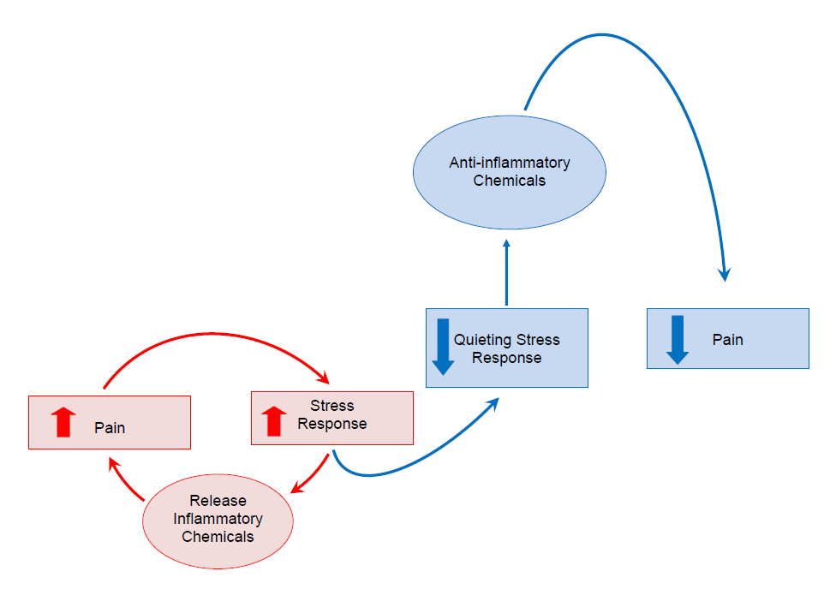
Stress response creates chemical changes that cause pain
Notes:
Now there is another part to all of this and that is the role of chemicals. Functions are turned on and off in the body and the brain through chemicals. When the emergency response system in the brain is mobilized because we sense that something is threatening, there is a series of chemical changes happen that help us respond to an emergency. And these chemical changes can, over time, cause feelings of achiness and pain all over the body. This may be part of the story for fibromyalgia for example, where you have pain everywhere, but you didn’t have injuires everywhere. These chemical changes have to do with your immune system, and sometimes give the feeling that you are getting sick, achey all over.

Slide 13
Parts of the brain that contribute to pain
Thinking
Feeling
Sensing
Moving
Notes:
The general functions of the brain that most frequently produce the pain response are involved in thinking, feeling, sensing and moving

Slide 14
Brain processes that affect pain: Feeling
Worse Pain:
Fears about the impact of pain on your future
Fear that doing something specific will hurt because it hurt before
Hopelessness
Notes:
In the feeling centers of the brain, you may have more pain if you have:
Higher stress
Fears about the impact of pain on your future
Fear that doing a specific thing is going to hurt, because it hurt before
Hopelessness
All of these things can make the pain worse

Slide 15
Brain processes that affect pain: Feeling
Less pain
Decreasing your pain be decreasing your stress
Having less fear of pain by understanding pain
Hopefulness about your ability to make things better
Notes:
The feeling part of the brain is very involved with pain, pain makes us distressed, sometimes worried, sometimes angry. The pain volume can turn down if you are able to :
Decrease your response to stress
Recognize how you can turn your pain around
Have Less fear from knowing that pain does not mean harm
You have Hopefulness about your ability to make things better

Slide 16
Brain processes that affect pain: Sensing
Worse pain:
If we move less and less we lose touch with our bodies
Begin to feel pain in a bigger area because the brain gets tricked
Notes:
The sensing part of your brain, the part that tells you what part of your body is doing what, can increase the pain volume if:
You begin to move less and less due to fear of pain. This causes us to lose touch with that part of our body and the brain gets tricked, so that you feel pain in a bigger area.

Slide 17
Brain processes that affect pain: Sensing
Less Pain
Less fear of pain, beginning to do more
The brain goes back to normal and you start to feel pain in smaller areas again
Notes:
The sensing part of your brain can decrease the volume again if you have:
Less fear of pain, beginning to do more
The brain goes back to normal and you start to feel pain in smaller areas again

Slide 18
Brain processes that affect pain: Acting/Moving
Worse Pain
We anticipate that something will hurt, because it hurt before
Notes:
When you’re fearful of pain, and if it seems that pain means that you have harmed yourself, you move less and less and the brain adapts to tolerating less and less activity before turning up the volume of the pain tune

Slide 19
Brain processes that affect pain: Acting/Moving
Less Pain
Less anticipation of pain
More willingness to get moving
Notes:
But, as you’re less fearful of harming yourself, you can begin to do more. The brain gets better at focussing on health activity and less interested in playing the pain tune.

Slide 20
Brain activity in a person experiencing persistent pain
Notes:
This is what’s called a functional MRI, an actual picture of the activity in a person’s brain when they are doing something, In this case, this person was taught a stomach strengthening exercise to help her back pain. She is doing this exercise while she is in the MRI, and this picture shows that the parts of her brain that produce a pain response are quite active, even though she is not moving her back. She is feeling very real pain in her low back, because the brain is producing the pain response.

Slide 21
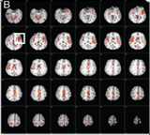
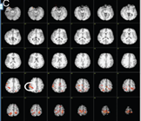
Before pain education
After pain education
Moseley, G. L, “Brain activity before and after 1:1 pain education with physiotherapist.” Australian Journal of Physiotherapy 2005 Vol. 51
Notes:
So the difference between the brain activity producing a pain response on the left, and the brain activity producing a pain response on the right, is that the person had pain education
Now during this study, there was also a test of her forward bend, Before the study, she had 5 degrees. After the pain education, she touched the floor. Now that does not mean that her physical therapist was a faith healer, but rather that the amount of threat she felt when bending over was very different and so her brain activity for activating a pain response was drastically decreases. Fewer brain functions were linked to the pain response.
So allow me to narrate. First time, bends over, reaches 5 degrees fwd bend, “OW, that’s painful, I cant do that!” Brain functions that get linked to the pain response: planning to bend over” “every time I bend over my back hurts.” The sensory part of the brain, associating sensation in the back with threat and pain, balance functions, including the weight shifting over the feet, inner ear motion; memory of having back pain in the past, fears about pain worsening.
Second time, she bends over, reaches 5 degrees fwd bend, “Ow!....Wait a minute, so you are saying that this is painful but not harming me. So I wonder what happens if I go a little further…” and down she goes. Now there is a different experience in the brain. Now her balance system, information on muscles stretching in her back, planning for movement, expectations, all of these functions have become coupled with the new experience of being curious, maybe hopeful, of the possibility that this might be safe, though uncomfortable. And so a very different experience, with less threat value. Those brain functions have become unlinked from the pain response.

Slide 22
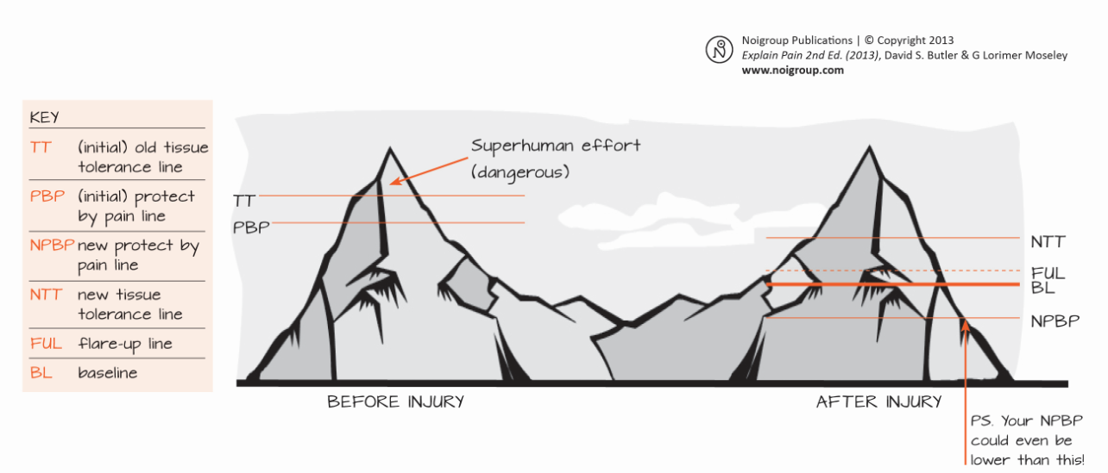
Pacing yourself to get back to your life
Butler and Moseley Twin Peaks model
Notes:
Draw peak with tissue damage level, and pain protection level, and then level of activity that can be maintained without pain or tissue damage in the normal state.
So here we see the level at which you could potentially injure yourself, whether from stretch, pressure, heat, cold. Just below that point, your brain and nervous system normally produces a pain response to protect you from that potential injury. It tells you: Stop that!
And below that pain level, you should be able to do all of your normal activities
Draw second peak, w tissue damage at top, pain level at bottom, and small amount of activity it takes to activate a pain repsonse but not tissue damage.
But with persistent pain, we see what happens when your brain and nervous system become too good at playing the pain tune. While it still takes a lot of input (heat, cold, pressure, stretch) to create injury, way up at the top, now you’re getting the pain response way down at the bottom. In other words, it takes very little activity to create pain, BUT you’re nowhere near causing damage from what you’re doing. No closer than you were before.
So, what we want to do is slowly increase what you do, hopefully without flareups, not because the flareup is a terrible things but because we want to quiet that whole response. And little by little, the threshold for pain goes up a little higher, and you can increase what you do a little. Then a little more and a little more as you adapt. So you may still have pain, but you are doing more and more and gradually your pain decreases as well. Like you start at 5 min walking, and keep that up for a week, pain or not, and don’t try to do more but also stick with it. Then after a week you increase by 1 min., and do that for a week….

Slide 23
Changes in the brain’s body map with pain
Notes:
Another change that can happen has to do with how we sense a part of our body. Now there is a map in our brain that allows us to feel when a body part moves and which one it is. That is how we know: that’s my back, that’s my hip, that’s my knee, etc. You can see from this picture that some parts are bigger than others. That is because this map is “use-dependent” meaning that the parts that give and get lots of information are more well-represented on the map, hands and face especially. And as we learn new skills , the part of our body that is involved in that skill becomes more well represented. One example of this is a study of monkeys whose fingers were tied together and after 20 minutes only the brain map changed on MRI from 2 fingers to one. 20 minutes only!! If you read braille during the week, the brain map for your index finger is different during the week than on the weekend,.
So if you avoid moving a part of your body, the map for that part can become blurred and smudged, harder to feel, feeling like the pain has spread, it’s vague, difficult to locate, and that can be scary. But remember, this is very changeable. The map can blur, and it can become more well-defined, depending on how much you get moving.

Slide 24
Indications of Central Sensitization
ADLs, particularly work, are severely interrupted
Pain felt in new areas, vaguely located, experienced all over the body, in large areas of pain body diagram
Depressed/anxious, pain occurs or increases with stress and emotion
Fear avoidance
Presence of swelling or color change occurring after the acute phase
Light touch or temperature change is experienced as painful
Notes:
Indications of central sensitization, or that pain is related to a sensitized nervous system and not to tissue problems are: see above

Slide 25
Persistent Pain program
Providence Rehabilitation Services
Works first to normalize the nervous system, rather than the tissues
Focuses on:
Self-efficacy
Education re neurophysiology of pain
Role of brain
Lifestyle modification
Notes:
How are we different from conventional therapy
In our approach to persistent pain, we work first to normalize the nervous system rather than the tissues. This is done most importantly by educating the patient about pain and what it really is. This begins the process of addressing central sensitization

Slide 26
Providence Rehab Services Persistent Pain Program
6-12 sessions weekly to monthly
Prescription: Persistent Pain Program PT/OT (or Chronic Pain), do not need to specify clinicians
Send records by fax
Notes:
We typically see patients in 6-12 sessions, 1 x weekly or more intermittently as they move towards self-efficacy
Prescription should say Persistent Pain or Chronic Pain PT/OT
Very helpful to send patient’s RECORDS in advance as they often have a complex history which is important for the therapist to be aware of

Slide 27
What we are not
We are not the miracle workers who can fix them when no one else could
We are not an integrated pain center
Rehab only, no MDs, no psych services, no medication management
Notes:
Important for the patient to know that we are not the miracle worker they have been looking for. We are going to help guide them on the process towards wellness.
We are not an integrated pain center. We are only rehab therapists, and do not deal with pain medication. We also do not have psych services

Slide 28
Who is NOT appropriate for the
Persistent Pain program?
Patients for whom mental health issues impair ability to participate in rehab services (refer to Behavioral Health first)
Patients who have orthopedic conditions that have not been appropriately treated yet
Notes:
Who is NOT appropraite to refer to us:
Patients w significant BH issues that interfere w ability to participate in PP program. These pts should be seen by BH first. When appropriate the patient can become involved in rehab after they have begun with BH. There should be communication between the clinicians.
If your patient has a condition that does not match the screening criteria, (eg the pain is in the same region, there does not appear to be marked psych overlay, etc) then this patient may do well to go into ortho therapy. Our therapists are all trained now to screen for PP and can internally refer as needed. You could also put something like “Consider PP program” on the referral to leave open to therapist judgment

Slide 29
What you can do
Reinforce that learning about pain and returning to activity are an important treatment for their pain

Slide 30
Questions?

