Slide 1
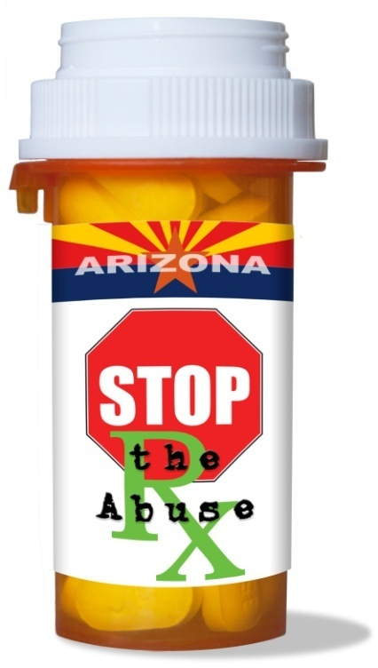
The Arizona Rx Drug Misuse and Abuse Initiative
A Multi-Systemic Approach for Addressing Arizona’s “Silent Epidemic”
Arizona Criminal Justice Commission
Statistical Analysis Center

Slide 2
Conceptual Framework
Targeted Increases (+) and Decreases (-)
SUPPLY
Attitudes & Awareness
Use of the PDMP
Scripts & Pills Dispensed
+
+
-
Health
ED visits
Deaths
NAS
Tx Admissions
-
-
-
Availability
Misuse and Abuse
Consequences
-
Crime & Delinquency
Rx Drug Investigations
DUI-D
School Suspensions
Drunk/High @ School
Youth Arrests
Lack of LE Training
DEMAND
Attitudes & Beliefs
Antecedent Behavior
-
-
Social Acceptance
Perceived Low Risk
Expectations of Health Consumer
Unsafe Storage & Disposal
Sharing Scripts
Lack of Resistance Strategies
Lack of Parent-Child Communication

Slide 3
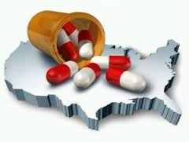
The Opioid Influx
A 4 fold increase in the quantity of Rx Pain Relievers sold in the U.S. in the last decade
The United States makes up 4.6% of the world’s population, but consumes 80% of its Rx opioids
    ~46 deaths per day!!!!!!!!!!
    Rx Pain Reliever deaths are greater than heroin and cocaine combined

Slide 4
The Problem?
~ 575 million Class II-IV pills were prescribed in Arizona in 2013
Pain Relievers had the highest % of scripts, pills and average number of pills per day; accounting for 57.4% of all pills prescribed
Hydrocodone and Oxycodone accounted for 82.6% of all pain relievers prescribed in Arizona
Why it matters = probability and access!

Slide 5
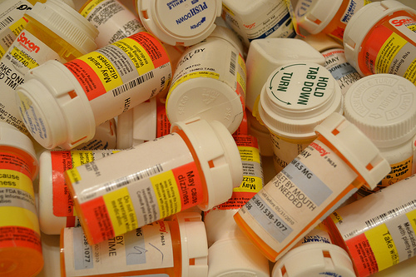
Volume:Access Ratio
Enough Rx pain relievers were dispensed last year to medicate every adult in Arizona around-the-clock for 2 weeks straight

Slide 6
WHO IS IT AFFECTING?

Slide 7
*Y-axis altered for visual purposes; accurate representation is out of 100%

Slide 9
What Is It Costing Us?
Mortality & Morbidity
    9,860 cases of opioid-related abuse and dependency cases in the ED – a 50% increase between 2008-2013
    Hospitalizations and emergency department visits for poisonings (Rx drugs are a leading cause) cost Arizona nearly a half a million dollars per day in 2012.
    1,099 drug-related deaths in AZ in 2013 – 41% involved Opioids/Opiates
Increase in Crime
    Narcotic drug possession increased 15% between 2010-2012
Increase in DUI-D
    4,073 DUI-D arrests in AZ – a 99.4% increase over the past decade
Increase in babies born with NAS
    3 out of every 1,000 babies born between 2008-2013

Slide 10
CONTRIBUTING FACTORS i.e., What is Amplifying this Problem and What Can We Change?

Slide 11
Difficult Balancing Act
Prescribers struggle with balancing the legitimate pain needs of their patients while ensuring their safety
Prescribers were told over a decade ago that they weren’t assessing pain well enough – Pain became the 5th Vital Sign
Inconsistent Guidelines
Unrealistic Expectations of the Health Consumer
Uninformed Patients and lack of education tools/resources
The Role of the CSPMP

Slide 12
Arizona= 32.5%

Slide 13
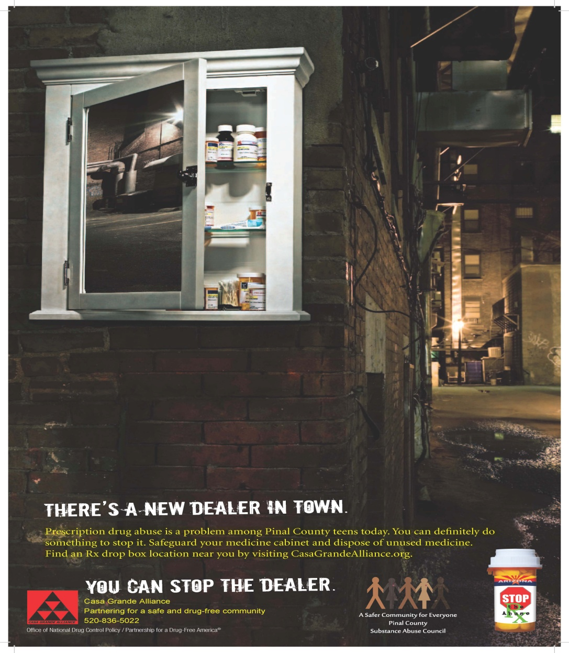
Easy Access
78.9% of Arizona youth who have misused prescription drugs in the past 30 days report getting them from friends, family or right out of the home

Slide 15
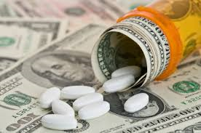
Diversion as a Business
Oxy and Hydro generate between $20-$80 a pill “on the street” depending on dose and formulation

Slide 16
FINDING A SOLUTION
The Arizona Rx Drug Misuse and Abuse Initiative
A Multi-Systemic Approach:
Medical/Treatment, Law Enforcement and Prevention

Slide 17
Initiative Ontology
ASAP
    Leveraging existing resources and partners
    Data-driven-decision-making
Expert Panel
    Public Health vs. Public Safety: a multi-systemic approach
Coalitions, Task Groups and Local Champions
    The vehicles of change
    “Home Grown” or “Backyard” approach
and

Slide 18
The Strategies
Reduce Illicit Acquisition and Diversion of Rx Drugs
Promote Responsible Prescribing and Dispensing Policies and Practices
Enhance Rx Drug Practice and Policies in Law Enforcement
Increase Public Awareness and Patient Education about Rx Drug Misuse
Enhance Assessment and Referral to Treatment

Slide 19
Reduce Illicit Acquisition and Diversion of Rx Drugs

Slide 20
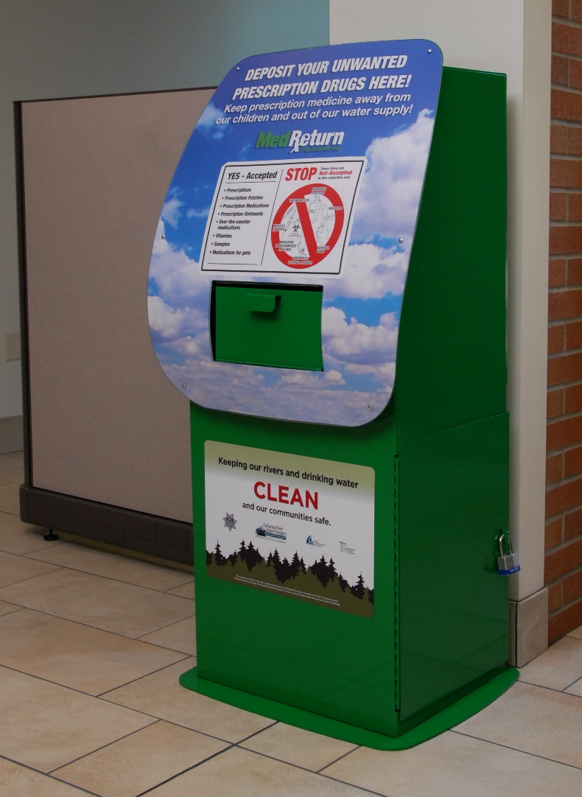

Install and Promote
Permanent Drop Boxes

Slide 21

Safe Storage

Slide 22
Promote Responsible Prescribing and Dispensing

Slide 23
Raise Awareness and Educate
Provide education and resources to balance legitimate pain needs with patient safety (i.e., minimize high-dose opioids, dangerous drug combinations and “doctor shopping”)
    Self-monitoring of individual prescribing habits (e.g., report cards)
    Use of the PDMP
    Adopt statewide clinical guidelines for prescribing and dispensing controlled substances
        Opioids in smallest dose possible and shortest time necessary
        Encourage non-narcotic alternatives and/or combination of therapies

Slide 24
Enhance Rx Drug Practice and Policies in Law Enforcement

Slide 25

HIDTA
Rx Diversion Crimes Training
Strategies and step-by-step guidelines for helping law enforcement officers conduct pharmaceutical drug diversion investigations
Topics include
    Rx drug trends Forged prescriptions
    Drug identification Doctor Shopping
    PDMP Diversion in a medical facility
    Internet Pharmacies Over-prescribing cases

Slide 26
Increase Public Awareness and Patient Education

Slide 27
Raise Awareness and Educate
Create a sense of urgency about the Rx drug misuse problem
Educate patients and the public about risks of misuse
    Taking more than prescribed
    Mixing with other drugs and/or alcohol
    Not sharing scripts with others and why
    Proper storage and disposal – especially if kids are present in the home
Get parents talking to their kids about risks, expectations and resistance strategies

Slide 28
The Rx360 Curriculums
Research-based curriculum adapted from DrugFreeAmerica’s Pact360 modules and localized to specific communities and populations in Arizona
Raises awareness of the Rx problem, the risks of misuse, resistance strategies and methods of proper storage and disposal
3 modules: Youth (middle and high school); Parent; Community (e.g., senior citizens and childless adults)

Slide 29
Messaging & Patient Education

Slide 30
Increase Access and Referral to Substance Abuse Tx

Slide 31
Resource Information
Screening, Brief Intervention and Referral to Treatment (SBIRT)
Additional screening tools: SOAPP; Opioid Risk Tool
Decision-trees (RHBA) for navigating Tx options and type
Accessing Tx through AHCCCS and the Affordable Care Act
MAT Training
Promotion of the SAMHSA Tx Locator Tool

Slide 32
Did it WORK?

Slide 33
Evaluation Highlights
Breadth, Depth and Efficacy
Did We Change Knowledge, Attitudes, Awareness, Beliefs and BEHAVIOR?

Slide 34
Process Evaluation Highlights
Cumulative Initiative Counties
The initiative counties have 40 Rx drug drop boxes and have held 46 take back events
7 of 9 hospitals are implementing the ED Guidelines or equivalent
Over 1,500 prescribers are receiving quarterly report cards
163 professionals have received comprehensive Best Practice training
Over 300 Law Enforcement Officers have received the Rx Diversion Crimes curriculum
13,198 youth and 1,328 adults have received the Rx360 curriculum
Over 26,000 people have been reached via community events
Over 900,000 people have been reached via public messaging and media methods

Slide 35
Impact Evaluation

Slide 36
Strategy 1:
Reduce Illicit Acquisition and Diversion of Rx Drugs

Slide 37
Goal: Install and Promote
Permanent Drop Boxes
15,000 lbs. of unused, unneeded and expired medication are no longer available for potential diversion.
117 Rx drug boxes are now available in Arizona – a 485% increase since June, 2012

Slide 38
Goal: Increase Knowledge and Awareness of Proper Disposal and Storage Methods
There has been a 76.7% increase in community awareness of drop box locations in the pilot counties
There has been a 55.6% increase in community awareness of take-back events in the pilot counties
There has been a 64.7% increase in knowledge of proper storage methods in the pilot counties
There has been a 179.3% increase in knowledge of proper storage methods in the pilot counties

Slide 39
Goal: Limit Youth Access
Arizona has seen a 10% reduction in youth obtaining Rx drugs from the home.
The “Friends and Family” plan has significantly decreased in Yavapai, Graham/Greenlee Counties and Casa Grande for past 30 day youth Rx drug misusers (range 29-68% reduction)

Slide 40
Strategy 2:
Promote Responsible Prescribing and Dispensing

Slide 41
Goal: Encourage Sign Up and
Use of the CSPMP
Arizona has seen a 118% increase in prescribers signed up to use the CSPMP system
    14.9% June 1, 2012
    32.5% January 1, 2014
Arizona has seen a 317% increase in pharmacists signed up to use the CSPMP system
    14.7% June 1, 2012
    61.2% January 1, 2014

Slide 45
Goal: Provide Education and Training and Increase Awareness of Individual Prescribing Habits

Slide 50
Awareness and Education
Provide education and resources to balance legitimate pain needs with patient safety (i.e., minimize high-dose opioids, dangerous drug combinations and “doctor shopping”)
    Adopt statewide clinical guidelines for prescribing and dispensing controlled substances
        Opioids in smallest dose possible and shortest time necessary
        Encourage non-narcotic alternatives and/or combination of therapies
    CME opportunities for opioid-prescribing education
    Self-monitoring of individual prescribing habits (e.g., report cards)

Slide 51
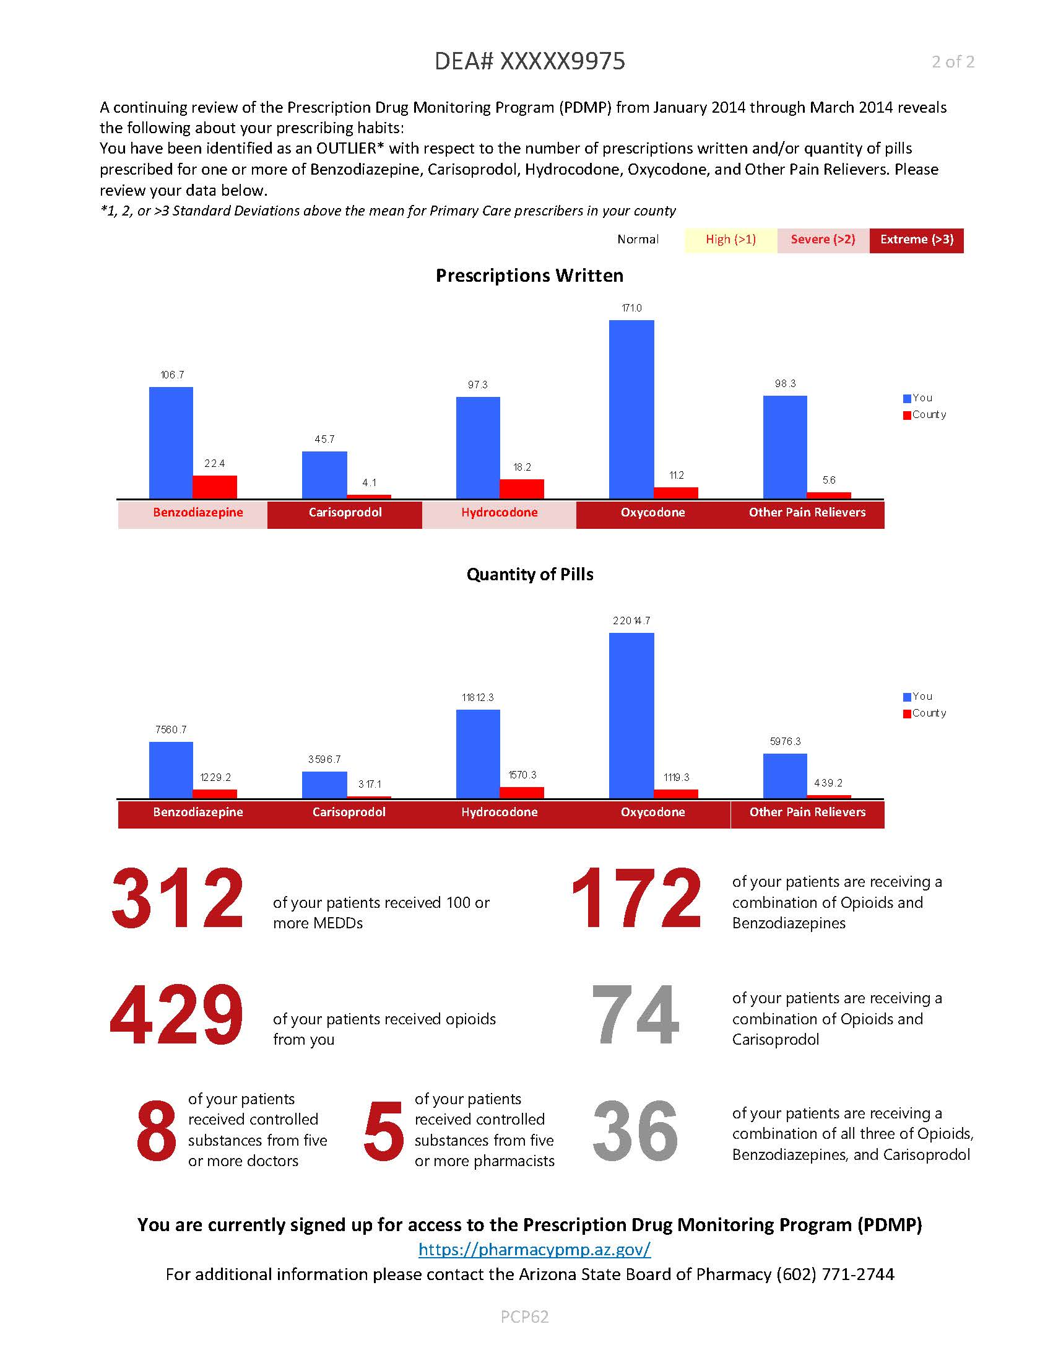
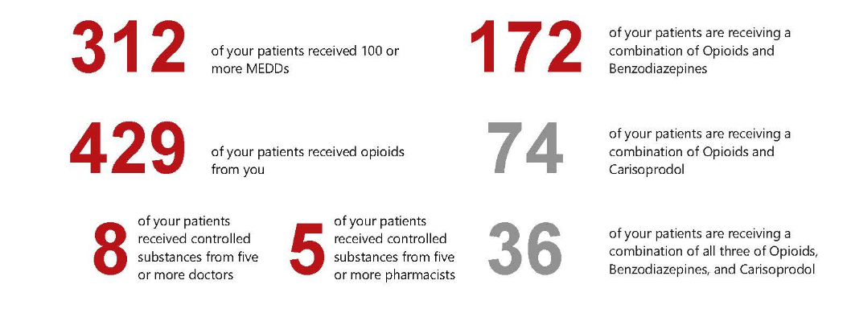
PDMP Prescriber Report Card

Slide 52
Strategy 3:
Enhance Rx Drug Practice and Policies in Law Enforcement

Slide 53
Goal: Increase Knowledge, Awareness and Use of the CSPMP
Law Enforcement PDMP sign up has increased 115% in Arizona and 140% in our Initiative counties
Awareness of the Rx problem significantly increased for officers who completed the Rx Drug Diversion Crimes training
Beliefs that law enforcement officers play an important role in prescription drug diversion significantly increased
Knowledge of specific information around Rx fraud investigation procedures significantly increased*

Slide 54
Strategy 4:
Increase Public Awareness and Patient Education

Slide 55
The Demand Side
Public Awareness of the Rx problem increased
Awareness of the risks of Rx misuse and abuse increased
Knowledge of proper storage and disposal increased
Parents became more aware of the importance of talking to their kids about Rx misuse and developing resistance strategies
Parents felt more equipped to have conversations with their kids about Rx misuse and developing resistance strategies

Slide 56
Goal: Increase Youth Perception of the Risks and Consequences of Rx Drug Misuse

Slide 58
Outcome Evaluation
Rates of Misuse, Non-Fatal Poisonings and Opioid-Related Deaths

Slide 63
Accomplishments
Almost 500 new prescribers signed up for the CSPMP in MC
Toolkit completed and dissemination has started
Statewide Summit – consensus and adaptation
Coalition buy-in session
Community Learning Collaborative
Identifying Champions
Pharmacy/Law Enforcement Partnership in progress

Slide 64
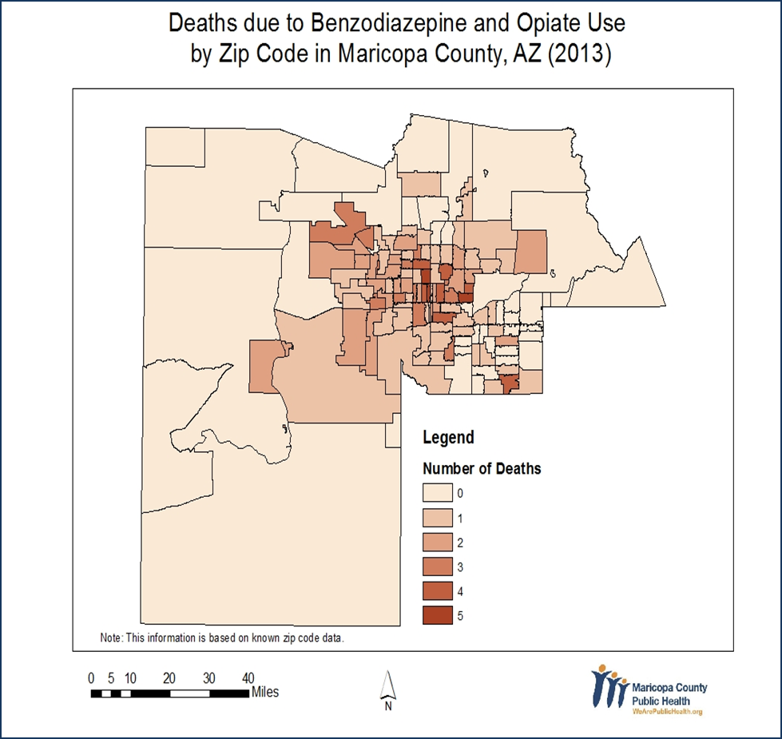
Future Plans
Expansion of drop boxes in local pharmacies
Sign up to Save Lives Campaign – Promote Delegates
Leveraging AHCCCS Health Plans
Report cards and regulatory boards
Key Stakeholders Group
Hot-Spot Mapping to target resources

Slide 65
Contacts
For additional information, please visit our website http://www.azcjc.gov/acjc.web/rx/default.aspx or contact:
Karen Ziegler (initiative co-chair): kziegler@azcjc.gov
Sheila Sjolander (initiative co-chair): Sheila.Sjolander@azdhs.gov
Shana Malone (county-level strategies): smalone@azcjc.gov
Dean Wright (PDMP specifics): DWright@azphamcy.gov
Shelly Mowrey (prevention): shellymowreymail@gmail.com
Tomi St. Mars (prescriber education): Tomi.St.Mars@azdhs.gov
Sara Salek (AHCCCS): SMSalek@azahcccs.gov
Jenna Jones (AZ D.O. Board): Jenna.Jones@azdo.gov
Carlena Orosco (coordination & TA): corosco@azcjc.gov
Danielle Dandreaux (coordination & TA): DANDRED@azdhs.gov
Kelly Charbonneau (DBHS): Kelly.Charbonneau@azdhs.gov
Kenneth Steel (Maricopa County Public Health): kennethsteel@mail.maricopa.gov
Kyle Gardner (Maricopa County Public Health): KyleGardner@mail.maricopa.gov
Tracy Cruickshank (Maricopa County Public Health): TracyCruickshank@mail.maricopa.gov
Jeanene Fowler (Maricopa County Public Health: JeaneneFowler@mail.maricopa.gov
Adonis Deniz Jr. (Mercy Maricopa): DenizJrA@mercymaricopa.org
Heather Brown (Mercy Maricopa): BrownH@mercymaricopa.org

